Slide 1

NEW Faculty Field Liaison Orientation
2020-2021
Gisele Ferretto, MSW,LCSW-C
Notes:
Checkpoints along the Field Continuum: Learning agreement, Assessments and Process recordings

Slide 2
Announcements Regarding CEUs
Office of Field Education is committed to offering field instructors and faculty field liaisons free workshops. Active FI and Liaisons will receive notices for these workshops throughout the year as they are developed.
Planned webinars (to date) for 2020-2021:
Tele-Behavioral Health Options in the Changing Landscape
Identifying and Addressing Microagressions
Developing the Social Worker's Role as Ally for LGBTQ+ Individuals
Supervising the Emerging Social Work Professional
Today’s webinar is not eligible for CEUs. Eligible workshops are on topics applicable for all social work professionals and not limited to field education.
The SSW Office of Professional Education CPE Office extends a discount to our current Field Instructors and Field Liaisons: 35% for full day offerings or 20% for half-day offerings ( some exclusions.) Check the BLOOM catalogue for CPE workshops.

Slide 3
Please review the NEW Field Instructors videos
Field Education Overview
Cultural Humility in Field Education
Conducting an Agency Orientation for New Students
Learning Agreements
Individual/Clinical Process Recordings
Macro Process Recordings
Field Instruction and Supervision
Student Evaluations and Performance Improvement Plans
Integrating Coursework and Field
(specific courses and recorded by teaching faculty)

Slide 4
Also please view the
NEW Student Field Orientation Videos
New Student Field orientation was comprised of two parts (Videos and LIVE Webinar)
Part 1: new students were instructed in early August to view 8 short videos prior to LIVE Field Orientation Webinars held week of August 17th
The video topics include:
Unit 1: Field is a Course: Assignments and Expectations
Unit 2: Cultural Humility in Field
Unit 3: Learning Agreements
Unit 4: Individual/Clinical Process Recordings
Unit 5: Macro Process Recordings
Unit 6: Being Prepared for Field Instruction and Supervision
Unit 7: Use of Self: Compassion Satisfaction and Compassion Fatigue
Unit 8: Ethical Responsibilities for Professional Social Work
Students were instructed to upload their Certificate of Completion onto their Electronic Field Notebook after completing all the videos

Slide 5
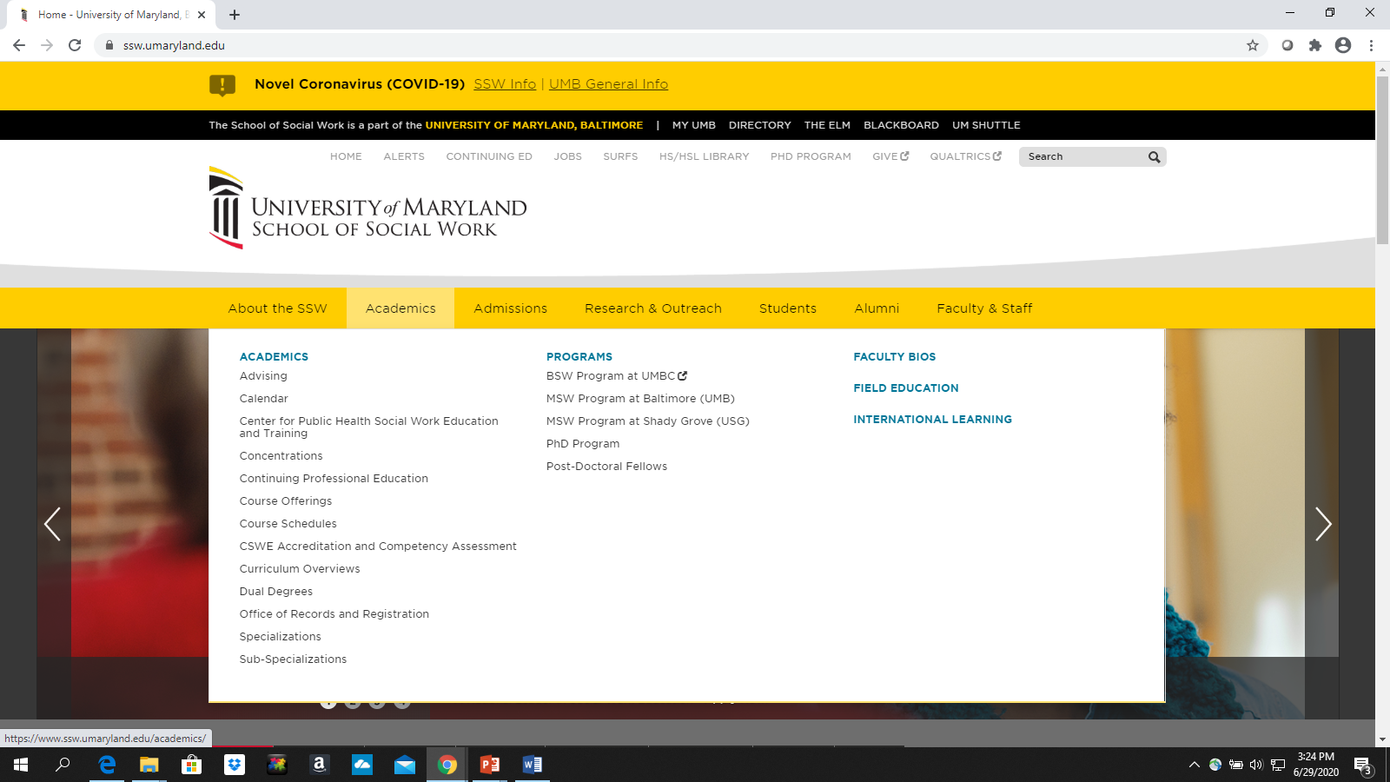
https://www.ssw.umaryland.edu/field-education/
Field Education page is under Academics

Slide 6
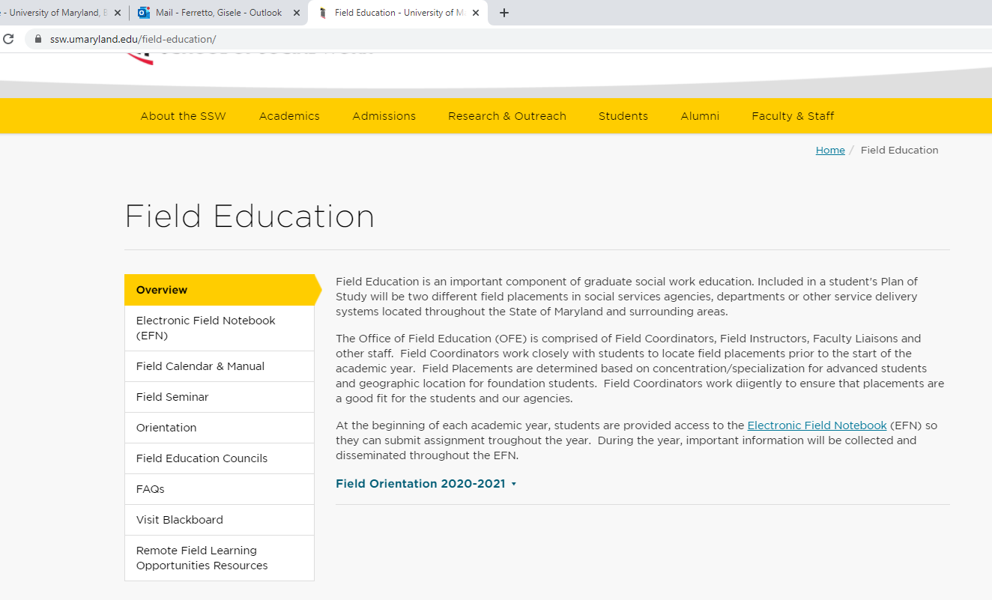
Location of Videos & Resources
FIELD INSTRUCTOR VIDEOS
STUDENT VIDEOS

Slide 7
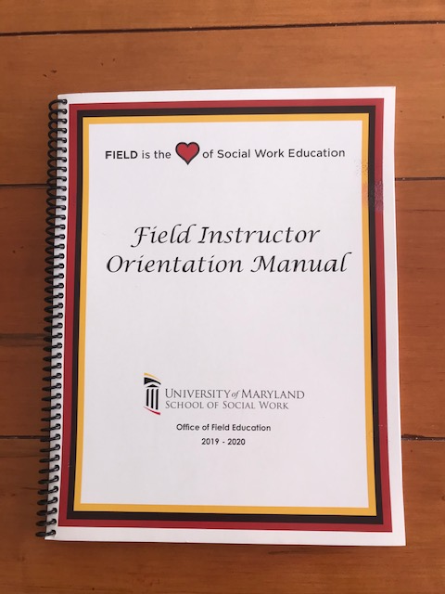
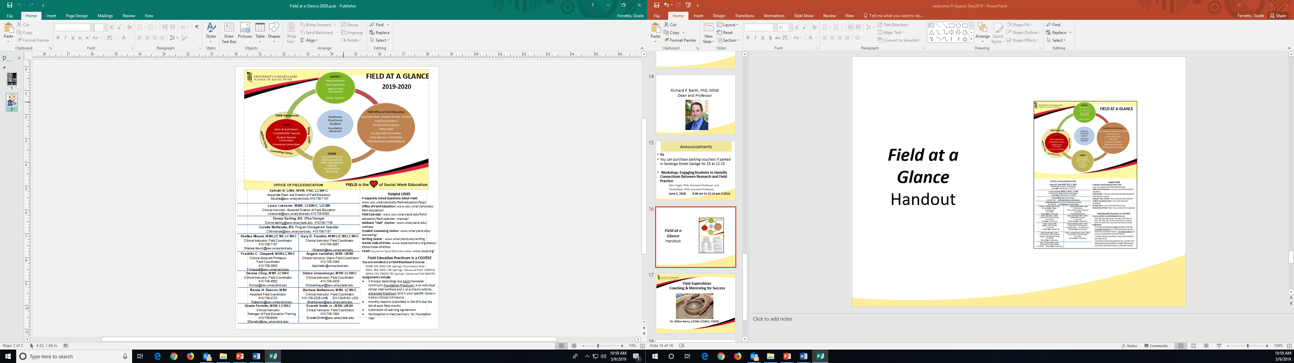

Handouts on website:
Field at a Glance: two-page summary that includes definitions of terms, helpful resources, summary of field assignments, and our contact information
The Field Instructor Orientation Manual includes PowerPoints from this orientation and other helpful materials specifically developed for Field Instructors
The Field Manual includes the SSW Field Policy for students and FI

Slide 8
Faculty Field Liaison: Role
Employee of UMB: Social Worker hired to support the educational placement
Connection between field instructor, student and UMB
Monitors progress in field: reviews work submitted in EFN and visit at least once a semester/visit more often if needed
Determines grade for field; assists to dev tasks to aid learning
FIRST level of SSW Problem Solving
Helps to make the connection between course work and social work practice
Student use the liaison as a resource for answering questions, discussing concerns

Slide 9
ROLES in FIELD
FACULTY FIELD LIAISON (Classroom Faculty or Adjunct Faculty)
SSW FIELD COORDINATOR
AGENCY FIELD INSTRUCTOR
AGENCY TASK SUPERVISOR
AGENCY FIELD COORDINATOR

Slide 10
OFFICE OF FIELD EDUCATION Samuel B. Little, MSW, PhD, LCSW-C Associate Dean and Director of Field Education
Laura Loessner, MSW, LCSW-C, LICSW Assistant Director of Field Education
Franklin Chappell, MSW, LCSW-C Field Coordinator | Monifa Johnson, MSW, LCSW-C Field Coordinator
Denise Chop, MSW, LCSW-C Field Coordinator | April Latson, MSW, LMSW Field Coordinator
Caron Cox-Branch, MSW,LCSW-C Field Coordinator | Debra Linsenmeyer, MSW, LCSW-C Field Coordinator
Donna Earling, BS Office Manager | Coretta McKenzie, MSW Program Management Specialist
Gisele Ferretto, MSW, LCSW-C Field Education Training Manager | Barbara Nathanson, MSW, LCSW-C Field Coordinator
Angela Jachelski, MSW, LMSW Field Coordinator | Everett Smith, Jr. MSW, LCSW-C Field Coordinator

Slide 11
Questions?
Contact your Field Office Coordinator
IF EFN issue contact the Office of Field Education general email:
fieldeducation@ssw.umaryland.edu
OR leave a message by calling the main phone line: 410-706-7187. A phone tree has been set up and Field staff will receive the voice mail messages electronically in our email.

Slide 12
FIELD is a COURSE
FOUNDATION Field Practicum and Seminar I &II:
  SOWK 635 (Fall), SOWK 636 (Spring)
Advanced CLINICAL:
  SWCL 794 (Fall), SWCL 795 (Spring)
Advanced MACRO:
  SWOA 794 (Fall), SWOA 795 (Spring)

Slide 13
You are supporting the field instructor and student for the achieve of 9 Core Social Work Competencies
1 | Demonstrate Ethical and Professional Behavior
2 | Engage Diversity and Difference in Practice
3 | Advance Human Rights and Social, Economic, and Environmental Justice
4 | Engage In Practice-informed Research and Research-informed Practice
5 | Engage in Policy Practice
6 | Engage with Individuals, Families, Groups, Organizations, and Communities
7 | Assess Individuals, Families, Groups, Organizations, and Communities
8 | Intervene with Individuals, Families, Groups, Organizations, and Communities
9 | Evaluate Practice with Individuals, Families, Groups, Organizations, & Communities
Notes:
1. Professional and Social Work Identity
2. Ethical Practice
3. Critical Thinking
4. Diversity in Practice
5. Human Rights and Social and Economic Justice
6. Research Informed Practice and Practice-informed Research
7. Human Behavior in the Social Environment
8. Policy Practice to Advance Social and Economic Well Being
9. Context Shaping Practice
10. A. Engage, B. Assess, C. Intervene, and D. Evaluate

Slide 14
Refer to
2015
CSWE EPAS: 9 Core Competencies and Behaviors
Handout

Slide 15
SSW FIELD CURRICULUM
Terms | FOUNDATION | CLINICAL | MACRO
Student Competency | 9
Practice Behavior | 31 | 16 | 17
Learning Agreement | Process completed in fall; reviewed during year
Learning Activities | Identified in fall; reviewed during the year
Student Assessments | FALL: Mid semester; end of semester SPRING: Mid-semester;end of semester
Evidence | At each assessment
Notes:
Foundation competencies and practice behaviors were identified by CSWE SSW developed the practice behaviors for advanced year.
Key Terms:
Learning Activities: Assignments that provide students with the opportunity to demonstrate their attainment of practice behaviors and related Core Competencies.
Competencies: The nine competencies listed in this form reflect what students must be able to do by the end of the academic year. Competencies are comprised of measurable practice behaviors.
Practice Behaviors: The practice behaviors operationalize each competency by describing knowledge, values and skills encompassed in the competency.

Slide 16
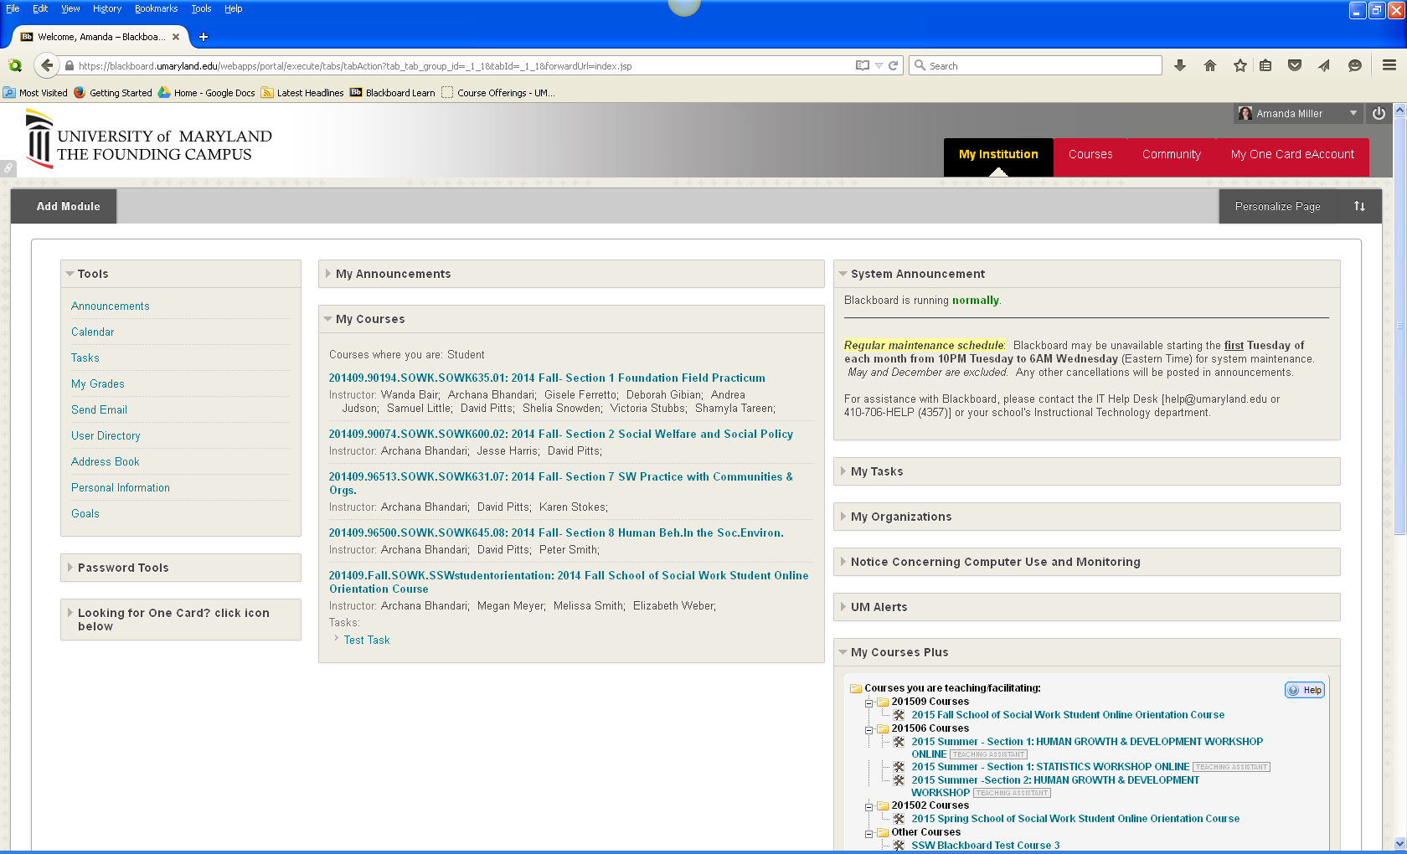
Students have a
BLACKBOARD COURSE for FIELD
Notes:
Not available to them till first day of classes

Slide 17
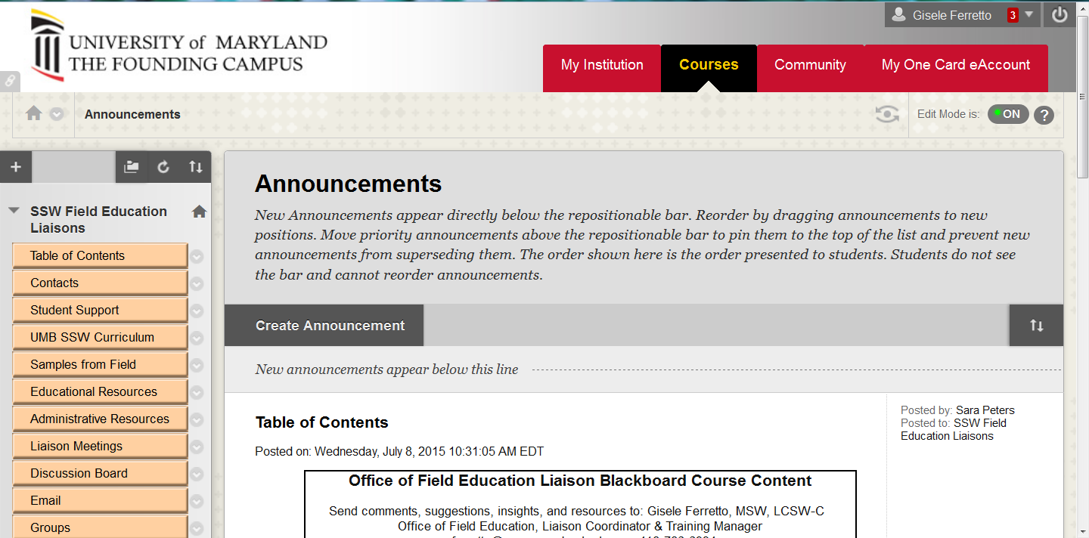
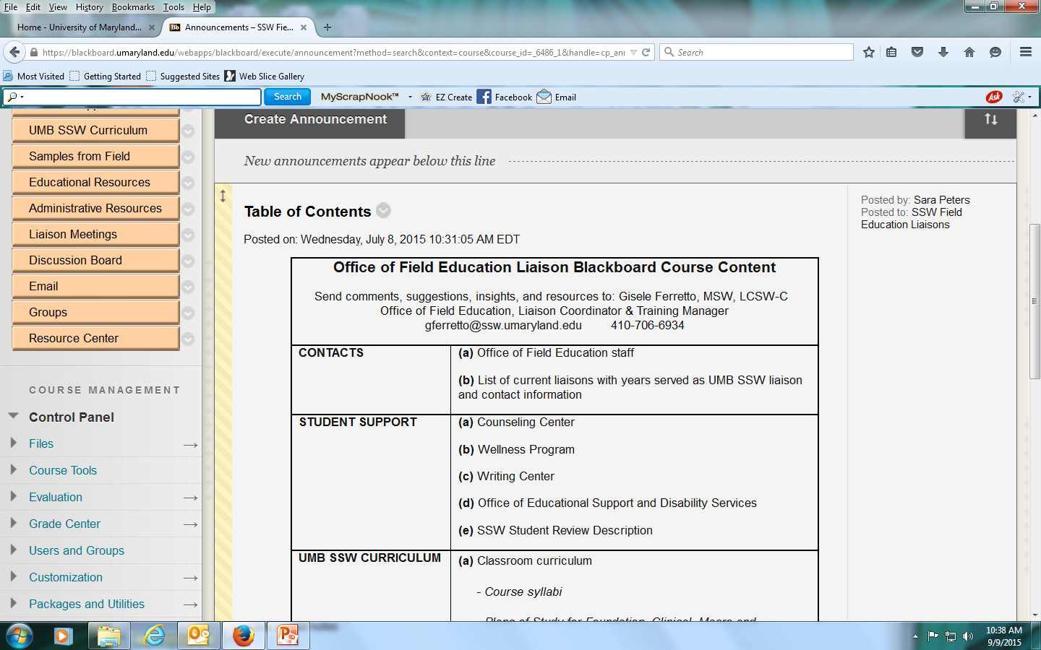
And so do LIAISONS

Slide 18
Student requirements for FIELD
Behavior | Adhere to NASW CODE of Ethics and SSW Code of Conduct
TIME | 2 or 3 full days in Field per week COMPLETE TIMESHEETS 2 days excused per academic year Missed time made up during the semester/notify Field Liaison IF AGENCY IS CLOSED FI may develop an alternative assignment or excuse student Foundation year: participate in seminar
Learning Agreement | Complete within first 30 days of placement Review and approval by field instructor Basis for assessment/evaluation
Process Recordings | At least 3 per semester
Monthly Reports | Monthly reports due 5th of the month

Slide 19
Helpful Tips for the Electronic Field Notebook EFN
Almost everything is submitted and reviewed in EFN Your user name and password for the EFN is the same username and password you use for MY UMB When EFN is down remind them that field placements were happening prior to computers!

Slide 20
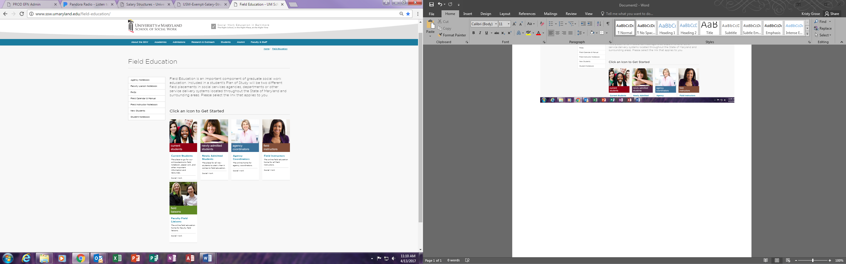
Electronic
Field
Notebook

Slide 21
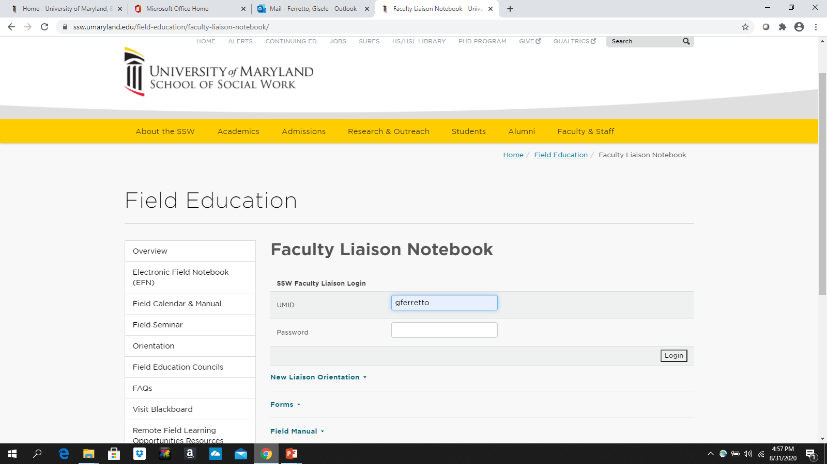
YOU set up your own username and password. If you ever you forget it just contact the Field Education office.

Slide 22
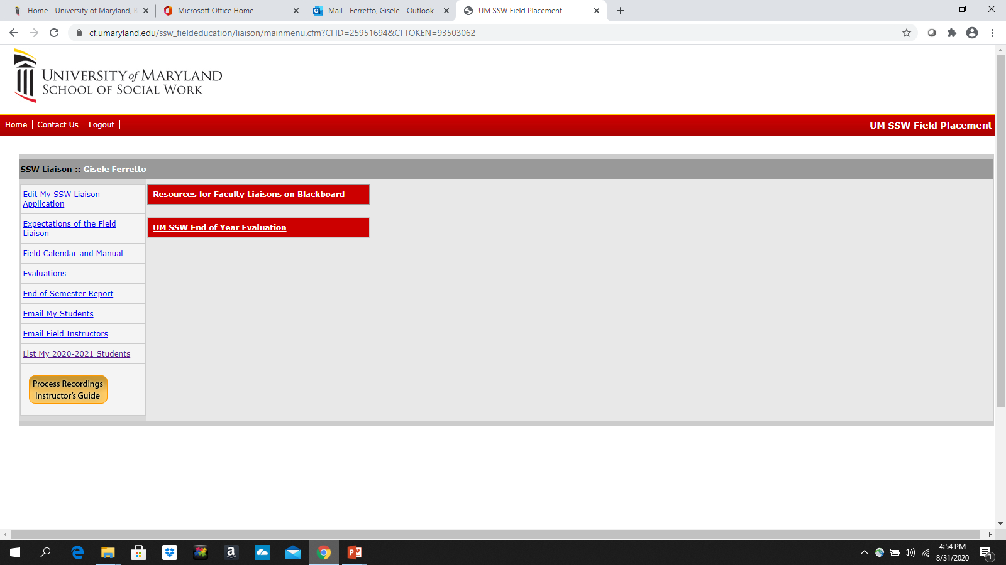
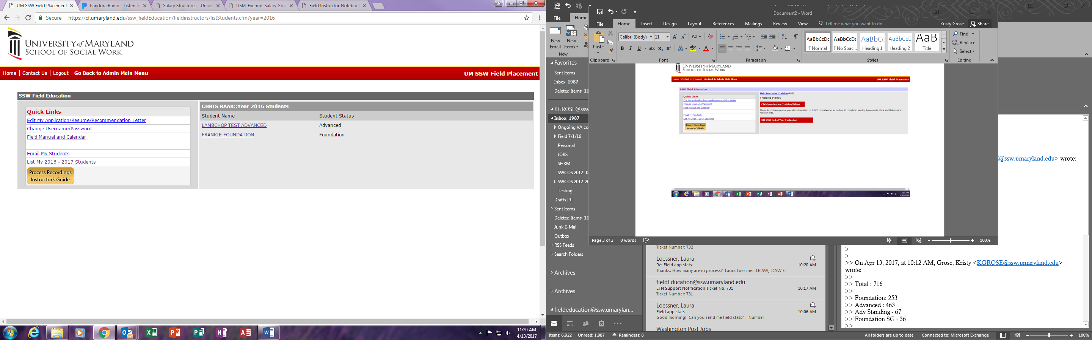
After you are in the EFN, you will see a link to the left of your student list.
Click on it and you will see the screen below.
The names of your students will be listed as links. When you click on the student name you will be directed to the main page of their specific file in the EFN.

Slide 23
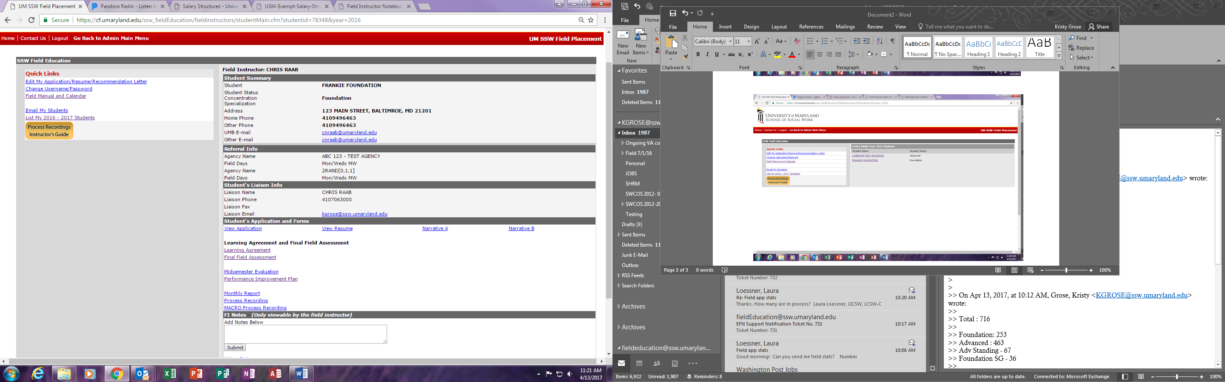
This is a sample of what a student’s main page looks like. From here you can navigate to all the items you will need throughout the semester

Slide 24
Link to the Classroom-FOUNDATION
Field work AND academic courses prepare students for social work practice
Practice courses are taken while students are in field | Assignments specific to FIELD
SOWK 630 Practice w/ Individuals | Skills Quiz (Process Recording) Psychosocial assessment and contract
SOWK 631 Practice w/ Organizations & Communities | Macro Field Activities Description (POLICY, CO, PROGRAM MANAGEMENT) Organizational Analysis Advocacy Intervention (may concern field)
SOWK 632 Practice w/ Groups & Families | Corresponds with group facilitation experience in the Spring semester

Slide 25
Link to the Classroom- ADV
Field work AND ALL academic courses prepare students for social work practice
Practice courses are taken while students are in field | Application of Theory Discuss the theory or theories used at agency Assist students in elucidating their own theoretical and practice frameworks Use of Evidenced Based Practice Does the agency have best practices or ways of working with clients that are based on evidence? Students explore the literature to see if research exists that could improve services to clients Discuss limitations or challenges to using evidence to guide service delivery
Any SWCL Methods/Practice Courses
Any SWOA Methods/Practice Courses

Slide 26
Relationship Relationship Relationship
Introductory Email to both
Reminders / Check-in emails
Review of Students’ Monthly Reports, Process Recordings AFTER FI, Timesheets
Visits
Send helpful resources, pass on and reinforce information from OFE

Slide 27
THE LIAISON VISIT
When NOT during a pandemic, … at Field Agency Site
Prior to Mid-semester Assessments
Review Learning Agreement
Sample agendas for visit
Things to check: supervision (both frequency and quality), site, safety sheet, macro assignment ideas, back-up, classes student is taking, expectations, individual goals, learning style, orientation to the agency, appropriate learning opportunities, student progress and motivation
Schedule with Field Instructor
Meet with:
  Field Instructor Individually
  Student Individually
  Student and Field Instructor Together
  Student, Field Instructor and Task Supervisor ( briefly)

Slide 28
Field INSTRUCTION: Supervision
Most important aspect of any field placement
Expectation: Field instructors provide one hour of supervision every week
Field Education Supervision is much more than task assignment
Students who are not receiving supervision on a regular basis are hesitant to ask for supervision. They worry about imposing their needs on a field instructor whom they view as very busy. Coaching students on how to ask for supervision can be helpful. Students need to make an effort before liaisons become involved.

Slide 29
Teachable Moments
Always looking for the lesson behind the behaviors that are concerning
Anticipate –look for “red flags” and support FI to teach the concept behind the behavior
You can identify assignments for FI/you to assign
  EXAMPLE: student came 1 hour and 45 minutes late for first day of field agency orientation
  ASSIGNMENT: review the NASW Code of ethics and identify what impact “being late” has on clients, agency, learning assignments, professional self and write 2-page reflection
If needed develop a Performance Improvement Plan

Slide 30
Some POSSIBLE situations to anticipate the need of the liaison
Student: Teachable Moments
  Lateness or absence
  Work/Class/Life Balance
  I don’t have any clients
Agency:
  Field instructor leaves the agency
  Macro assignment & Group Work
  New FI or “assigned” by agency to serve as FI

Slide 31
Concerns: student/agency
When approached by either a student or a field instructor provide supportive coaching or clarification as needed.
Best not to become directly involved (at first):
  unless the student and field instructor have met directly to discuss the concerns, but have been unable to successfully resolve the concern
  Concern involves matter requiring immediate attention: sexual harassment
If concerns remain, schedule a meeting with the field instructor and student
At the meeting, complete a Performance Improvement Plan, if necessary This form outlines expectations, provides benchmarks, a timeline and consequences if expectations are not met.
All sign the plan and liaison submits a copy of the PIP to the OFE
If needed, return for a visit to review the student’s progress towards identified goals. If the student has not made sufficient progress, it may be necessary to fail the student, and/or to discontinue the field placement.

Slide 32
Tools for Learning & Liaison Role :
1. Learning Agreement
2. Assessments of Student Progress
3. Process Recordings
4. Monthly Reports

Slide 33
Learning Agreement Process | Learning Agreement Product
JOINT effort Ask students to think about their learning style and how they will achieve the core competencies in agency context Have Field Curriculum handy Discuss examples of activities that provide opportunities to achieve each competency in your setting Organic and developing | EFN Form Generated by Student Due: September: Regular Schedule October: ADV w/Extended Schedule More than Intern Position Description Tied to Field Course material Unique to the student They are unique to each particular student their needs, learning style, experience, specific curriculum Revisit it & modify
Notes:
PROCESS: Opportunity to discuss/ demonstrate to the student Field instruction is “more” than supervision
Organic and developing- modify to provide clarity and make adjustments
In the context of agency: students may say they do not have “client” or do “assessments” if these look different than what they expect. Example: If they supervise lunch time at school they can assess.
UNIQUE to STUDENT: I noticed my advanced macro student was so introverted she attended 4 meetings on a project she was working on and she said nothing –yet in supervision identified insightful points that needed to be shared.

Slide 34
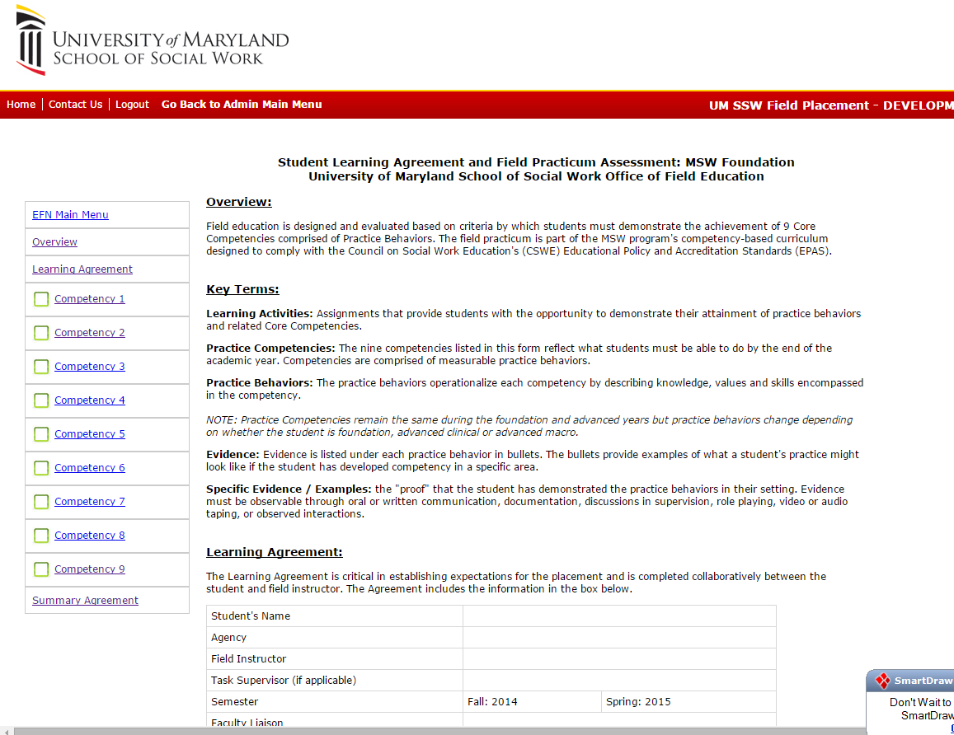

Slide 35
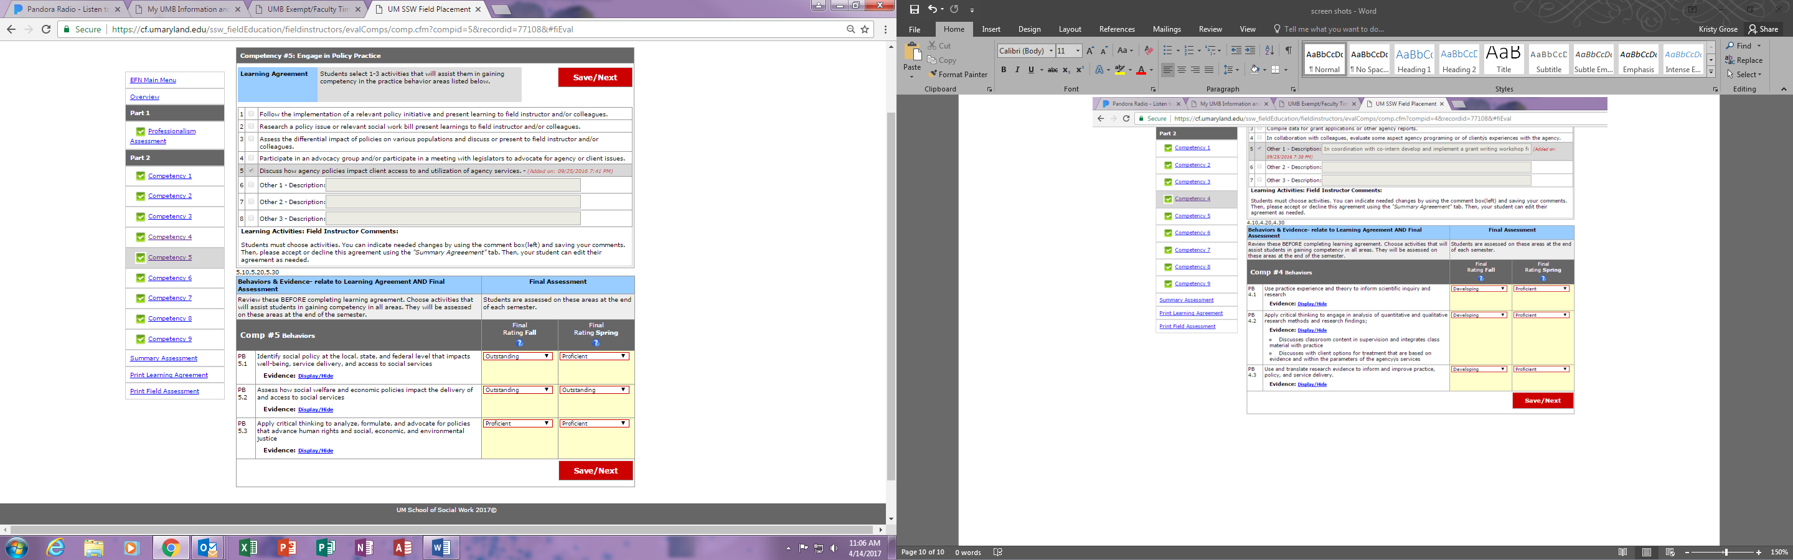
Learning Agreement: the top part

Slide 36
Learning Agreement: the top part
PROCESS Options to share:
FI & student discuss in supervision
Have students give FI updates as competencies are completed
Complete together from student’s EFN
Have student submit to EFN and FI makes changes after submitted

Slide 37
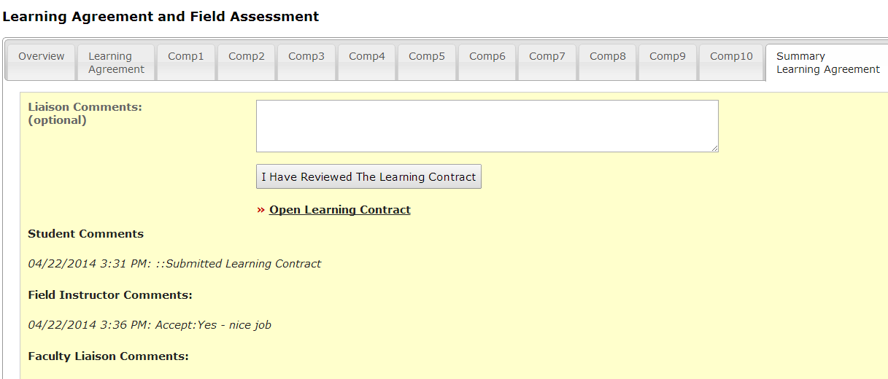
.
.
.
.
Summary Learning Agreement - Liaison
SECOND SEMESTER: Liaison could suggest specific learning activities to the Field Instructor as you get to know the student and the agency
Notes:
Once the student has clicked on all ten competency tabs, he/she will click on the tab called “summary agreement”.
On this tab the student will click a box to indicate that this is their final draft, they can write comments and then they click a button that says submit my learning contract.

Slide 38
Assessment of Student’s Level of Competency & Liaison Role
Notes:
Checkpoints along the Field Continuum: Learning agreement, Assessments and Process recordings

Slide 39
Assessment Process | Assessment Product
Feedback on strengths and areas for improvement Discussion: Specific and descriptive Connect to Core Competencies Part of every supervision Part of every process recording Self-Reflection exercise: Have students complete one and bring to supervision to discuss | EFN Form Generated by FI 4 students assessments Fall Mid-Semester End of Fall Semester Spring Mid-Semester End of Spring Semester

Slide 40
Concerns about student’s skills/competencies/ performance
FIELD INSTRUCTOR with concerns:
1. Contact your liaison to discuss concerns
In collaboration with the liaison, draft a Performance Improvement Plan (Instructions to find the Performance Improvement Plan will be provided in EFN w/ screenshot.)
Submit the plan through the EFN by (1 week)
Field LIAISONS: Before you can accept the mid-semester evaluation
Message: field instructor has concerns about this student’s performance in field and an email will be sent to them by EFN
1. Contact the field instructor to discuss concerns
2. Assist the field instructor in drafting a performance improvement plan and support the instructor in implementing the plan.

Slide 41
Performance Improvement Plan
A documented way to address a student’s ongoing pattern of behavior that if not corrected could lead to a failing grade and/or termination from the agency.
It’s a written plan created by the field instructor
Puts the responsibility on the student
Should be done as early as possible when you notice change is not happening*

Slide 42
END OF SEMESTER: Student Assessment
Grade each semester: Pass or Fail
Pass also includes:
  Liaison review of their required hours
  Three Process Recordings completed
  Monthly reports Completed
Accomplishment of the competencies are
    Measureable, behavioral, observable
    Relate to competency demonstrated
After fall assessment is complete look for “No Opportunity” and “Needs Improvement” or “Unsatisfactory” and follow up with FI and student

Slide 43
Rating | Definition
Outstanding | Student CONSISTENTLY EXCEEDS expectations related to the practice behavior.
Proficient | Student CONSISTENTLY MEETS expectations related to the practice behavior.
Developing | Student GENERALLY MEETS expectations related to the practice behavior.
Needs Improvement | Student INCONSISTENTLY MEETS expectations related to the practice behavior. There are performance indicators that the student can meet the expectations with additional guidance and direction.
Unsatisfactory | Despite being given opportunities, student NEVER or RARELY MEETS expectations related to this practice behavior.
NO OPPORTUNITY | Student did not have an opportunity to demonstrate this practice behavior by the date of this evaluation.

Slide 44
Rating Criteria
Competency is Developmental and Life Long
What stage of development you would expect a social work student at the beginning practice level OR advanced practice level (Cl or Macro)
Identifies the level by which a student demonstrates the competency at WHAT YOU WOULD EXPECT AT THE END OF EACH SEMESTER
We expect continued growth in second semester

Slide 45
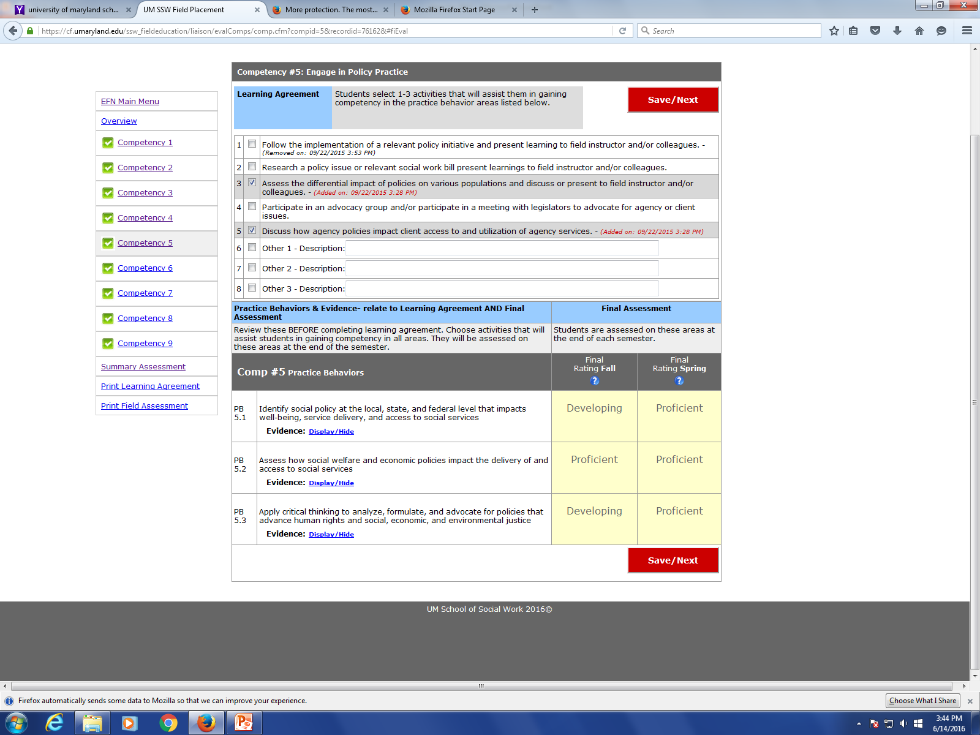
Learning Agreement and Assessment are ONE form
Competency #2 Engage Diversity and Difference in Practice

Slide 46
The Process Recording:
The Social Work Student’s Reflection and Role Of Liaison

Slide 47
Requirements
All students are REQUIRED to complete at least 3 process recordings per semester
Foundation students at least ONE (of the 6) must reflect an intervention with a group or organization (macro system)
Process Recordings must be submitted with field instructor’s comments by the 5th of the month to their faculty liaison
Support the importance of Process Recordings

Slide 48
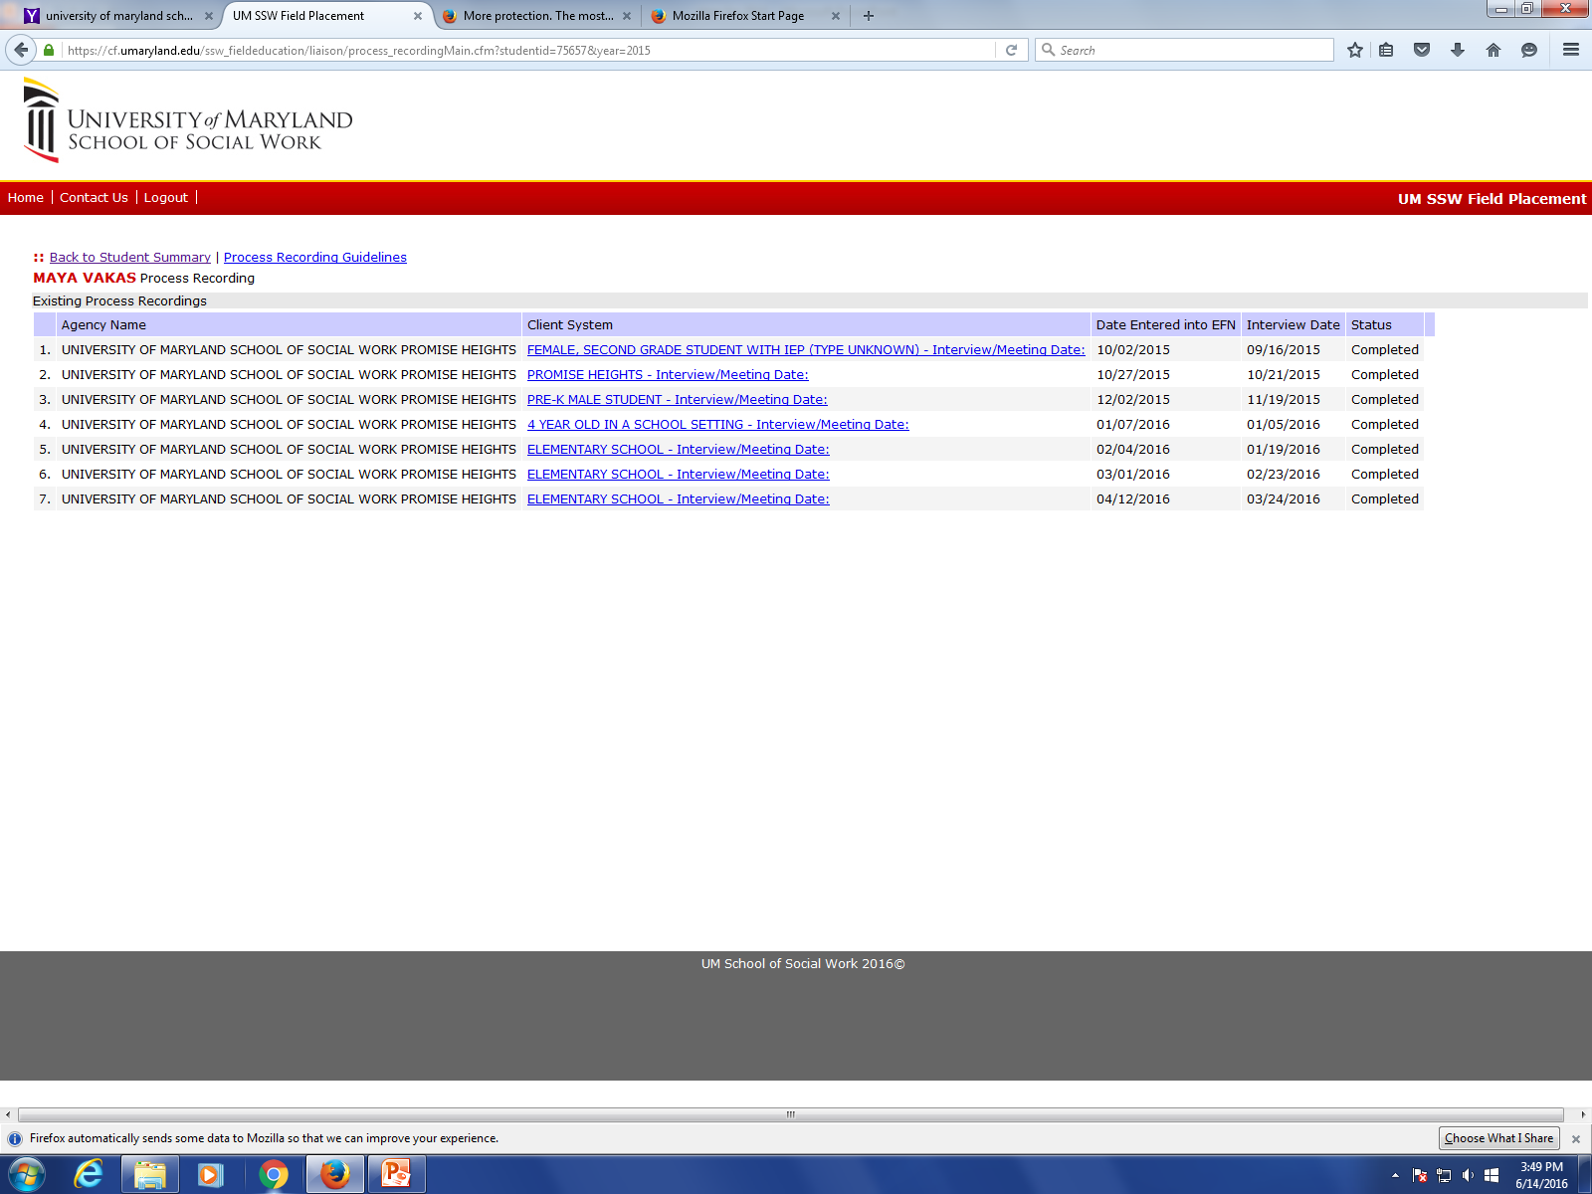

Slide 49
PROCESS RECORDING (Individual System)
Student: |  |  | Date: Date of interview
Agency: (Full) Name of Field Agency |  |  | Client System: Individual, Couple, Family…
Presenting Issue: Specific presenting issue for the client. Why the client is getting services?
Purpose: Specific reason for THIS intervention. Connection of this meeting to goals/service plan
Diversity Pre-Reflection: What do you anticipate or note about the similarities and differences between you and your client that may have an impact on your interview?
Worker/Client | Content | Skills Used |  | Gut Reaction | Analysis | FI Comment
Identify who the content is generated from. No names Minimum rows | To the best of their ability they record verbatim the dialogue and interaction | (REAL) Social work skill used for each of their rows of content REAL:Cournoyer, MI, CBT, etc. |  | THEIR gut reaction. Name their feelings NOT client’s feelings | Thoughts about the skill chosen, effectiveness, client response, etc. | Specific feedback on columns to left and adjacent rows
Student Assessment Narrative: Analyzes their overall effectiveness. Patterns, Dynamics, Types of Skills used, Insight, …AND their “next steps” to continue moving toward the service goals.
Diversity Post-Reflection: Consider what you anticipated about similarities and differences between you and your client. How did those similarities and differences impact the interview? Did you do something to ensure similarities and differences were considered?
Field Instructor Overall Comments: Think Developmental. Feedback on intervention as a whole.
Liaison Comments: usually after the field instructor comments

Slide 50
PROCESS RECORDING: Macro System
Student: | Date: date of macro intervention/event
Agency | Describe the System: (Examples: Committee, Coalition, Unit, Community) Include length of time this group has been gathering.
Identify and describe the event: Include: purpose, time and length, specific location, who called or led the event, number in attendance and agencies/organizations represented. How were participants notified of event.
Presenting Issue/Goal: Describe the target goal/ presenting issue/Problem being addressed by the group
Purpose: Specific reason for THIS event or intervention. The goal or expected outcome of this intervention and how is connected to the overall target goal. Was there an agenda?
WHO: Identify the individuals present and their role/title. Identify their organization or role. Discuss the composition /diversity of the group (including gender, race, socioeconomic status, age, religion/spirituality, culture..)
Role of student . Describe your role and assigned tasks at this event and relationship to group. Self-assessment of your performance at event. Content learned about your macro practice from this event.
Content of the Event: (1) Discussion Points (2) Action(s) taken/decisions made. (3) Action(s) Planned, persons identified as responsible
Feelings: Identify (your) feelings and emotions generated by event, participants, issues, role.
Power: Dynamics of power and influence (who has it, how displayed). Multiculturalism and Oppression
Student Assessment Narrative: Analyzes overall effectiveness of the event - what went well and what could have been improved and how. Patterns, Dynamics, Types of Skills used and observed. Formal and informal leadership.
Next Steps: Identify the “next steps” you suggest to continue moving toward the goals identified above.

Slide 51
Field Instructor PR Comments
EFN: Enter comments opposite the material recorded in the content/dialogue column and overall comments at the end
Liaison cannot enter grade unless FI Comments are provided
Field INSTRUCTOR Comments:
  May refer to statements in the Skills Used, Gut Reaction or Analysis column or Presenting Issue, Purpose, or Student Assessment Narrative
  May refer to patterns or themes you notice in their work; client system dynamics or indicators; variety of possible options for feelings or actions individual displays; next steps
  Identify strengths and areas for improvement
  Specific and concrete
  Raise questions for the student to think about, suggest alternative responses or techniques, point out indicators

Slide 52
Liaison Activities Concerning
Process Recordings
Reminders
Identify class content
Provide comments on length, patterns, not client effectiveness
Build Capacity of Field Instructor
What to do when Field Instructor does not provide any comments

Slide 53
Monthly Reports:
Keeping on Track
And Role Of Liaison

Slide 54
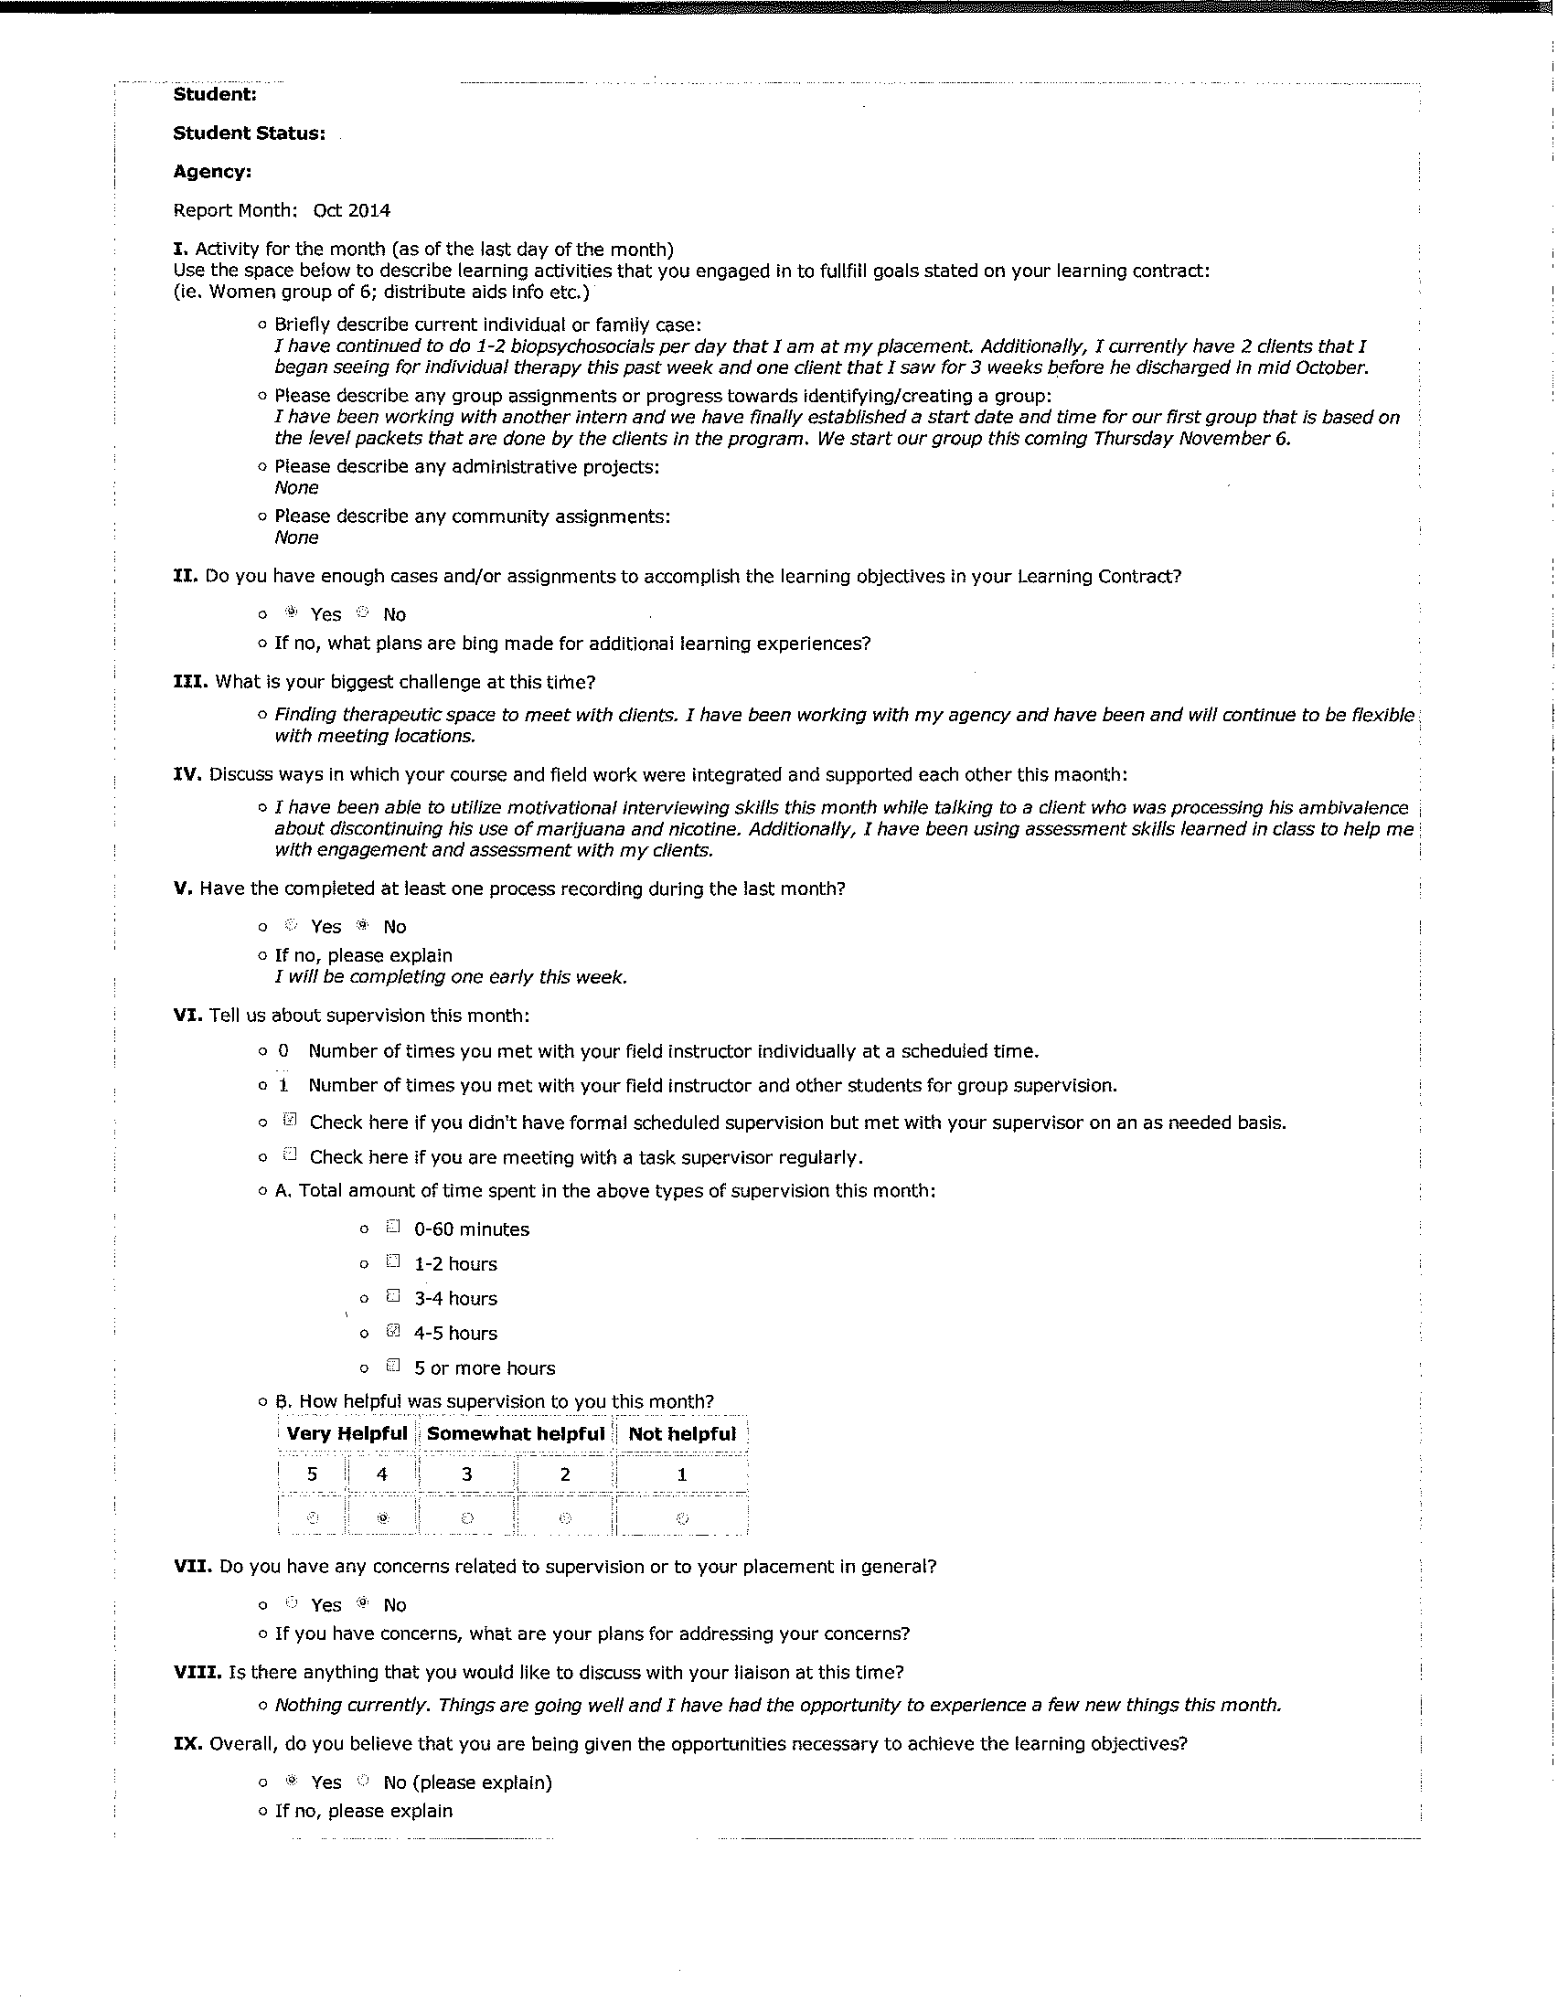
Foundation & Clinical
Monthly Reports
Submitted in EFN
Due 5th of the month:
  Briefly describe activities
  Do you have enough cases?
  Biggest challenge/ success
  Integration of coursework & field
  Reflect on experiences in your internship that relate to diversity, inclusion, oppression, privilege.
  Did you complete PR?
  Days in Field
  Supervision *
  Concerns *
  Anything to discuss *
  Overall*
Notes:
There are now two versions of the Monthly Report one for Foundation and Advanced Clinical students and the other is for Advanced Macro Students.
They are both due on the 5th of each month.
The Foundation/Clinical Monthly report has nine parts….. (slide)

Slide 55
Macro Monthly Reports
Due 5th of the month
  Describe macro activities
  Biggest challenge/ success
  Integration of coursework & field
  Reflect on experiences in your internship that relate to diversity, inclusion, oppression and/or privilege.
  Did you complete Macro PR?
  Days in Field
  Supervision *
  Concerns *
  Anything to discuss *
  Overall*
Notes:
The Macro Monthly report is slightly different because their focus is on Marco activities rather than individual clients.

Slide 56
Suggested Readings
Bogo, M. & Vayda, E. (1998). The practice of field instruction in social work: Theory and process (2nd ed.). New York: Columbia Univ Press.
Deal, K (2000). The usefulness of developmental stage models for clinical social work students: an exploratory study. The Clinical Supervisor, 1-19.
Hendricks, C. O., Finch, J. B., & Franks, C. L. (2005). Learning to teach, teaching to learn. Alexandria, VA: Council on Social Work Education.
Friedman, B. D. & Neuman, K. M. (2001). Allegiances in social work education. Journal of Teaching in Social Work, 21(3/4), 123-135.
Garthwait, C. L. (2011). The social work practicum: A guide and workbook for students. Boston: Allyn & Bacon.
Shulman, L. (1993) Teaching the helping skills. Council on Social Work Education; 2nd edition.
Wilson, S. J. (1981). Field instruction: Techniques for supervisors. New York: The Free Press.
Wilson, S. J. (1980). Recording: guidelines for social workers. New York: The Free Press.

