Slide 1
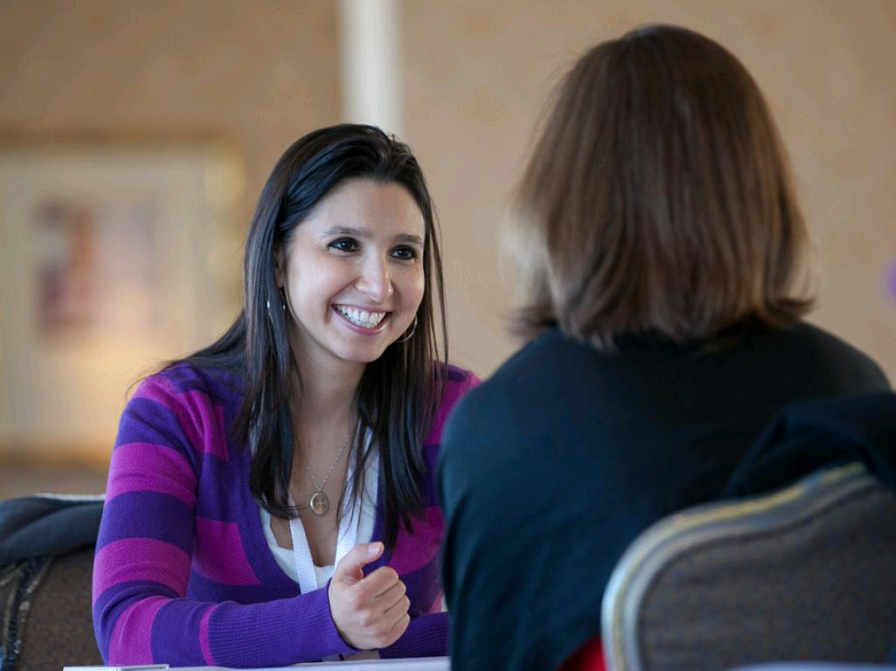
Qualities of a Good Mentor
cc: jdlasica - https://www.flickr.com/photos/36521958135@N01

Slide 2
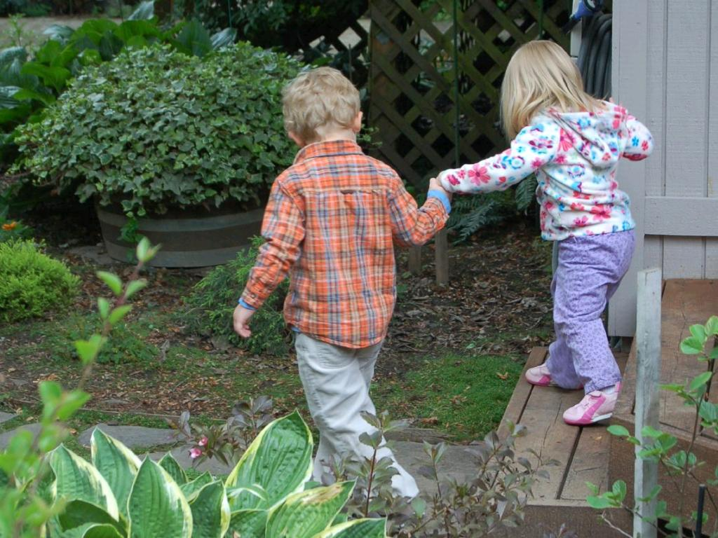
Encouraging
Pushes and supports you on your journey
cc: Mandajuice - https://www.flickr.com/photos/60449310@N00

Slide 3
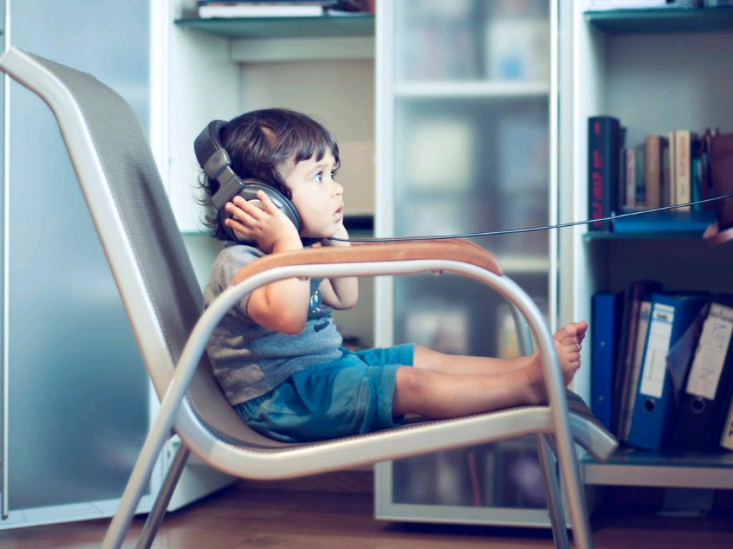
Good listener
Use active listening skills
cc: Philippe Put - https://www.flickr.com/photos/34547181@N00

Slide 4
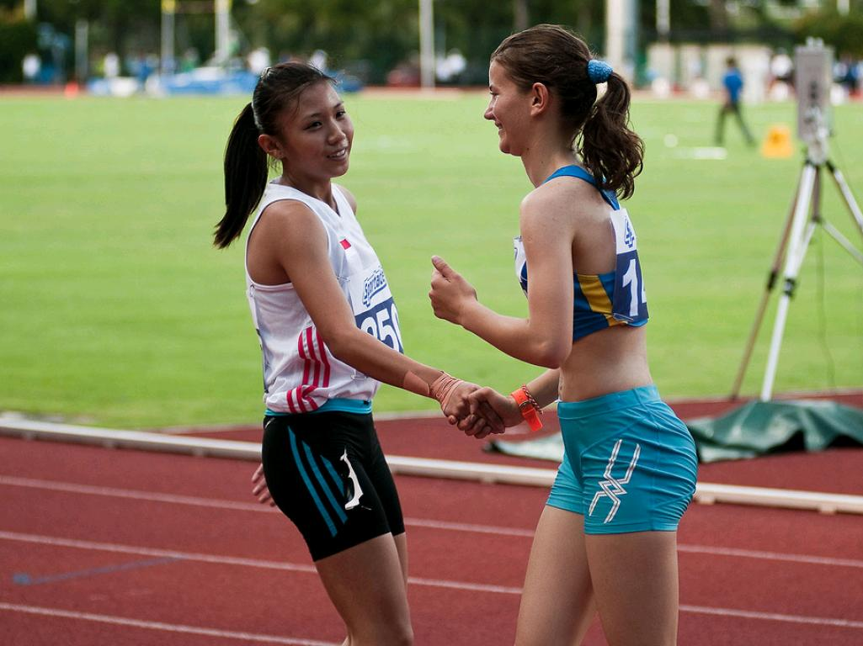
Acknowledges your accomplishments and empathizes with your hardships
Validating
cc: Singapore 2010 Youth Olympic Games - https://www.flickr.com/photos/15322733@N05

Slide 5
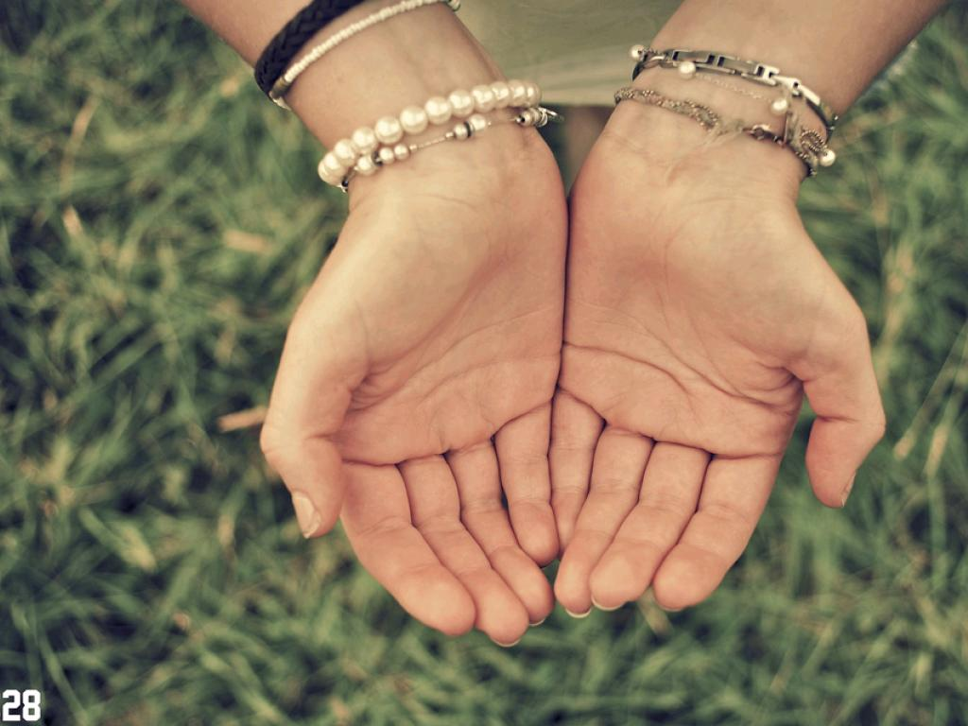
Holds you accountable
Makes sure you meet your goals
cc: thebarrowboy - https://www.flickr.com/photos/48778414@N04

Slide 6

Knowledgable
Knows who to ask and where to find the answers
cc: Halans - https://www.flickr.com/photos/48889073931@N01

Slide 7
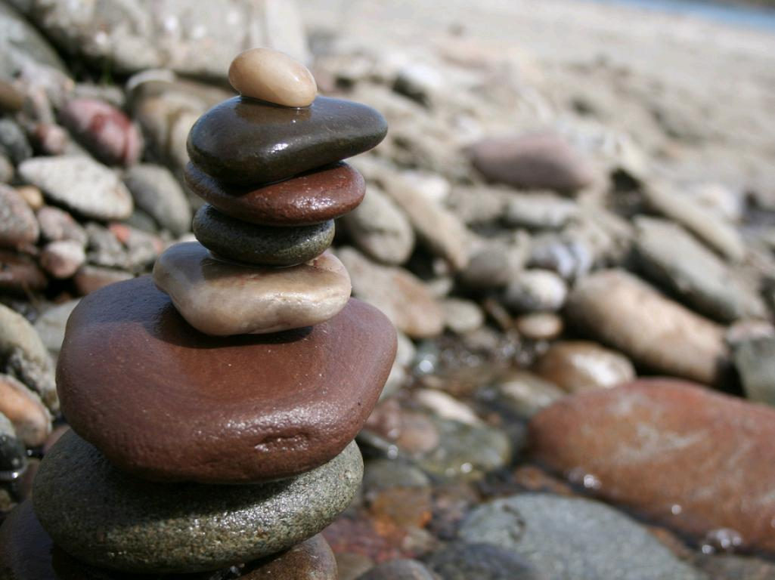
Balances competing demands
field, classes, family, friends, work
cc: aeu04117 - https://www.flickr.com/photos/29909815@N00

Slide 8

Nonjudgemental
Doesn't judge you based on race, class, gender, or experience
cc: ccPixs.com - https://www.flickr.com/photos/86530412@N02

Slide 9
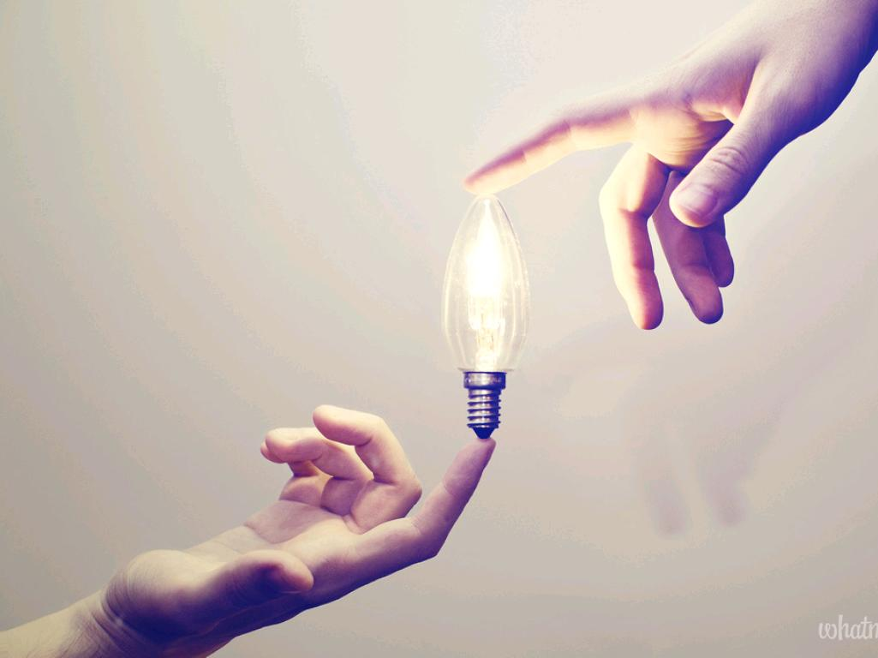
Fosters connections
to professors
to peers
to internships
to the community
to opportunities
cc: whatmattdoes - https://www.flickr.com/photos/29439891@N08

Slide 10
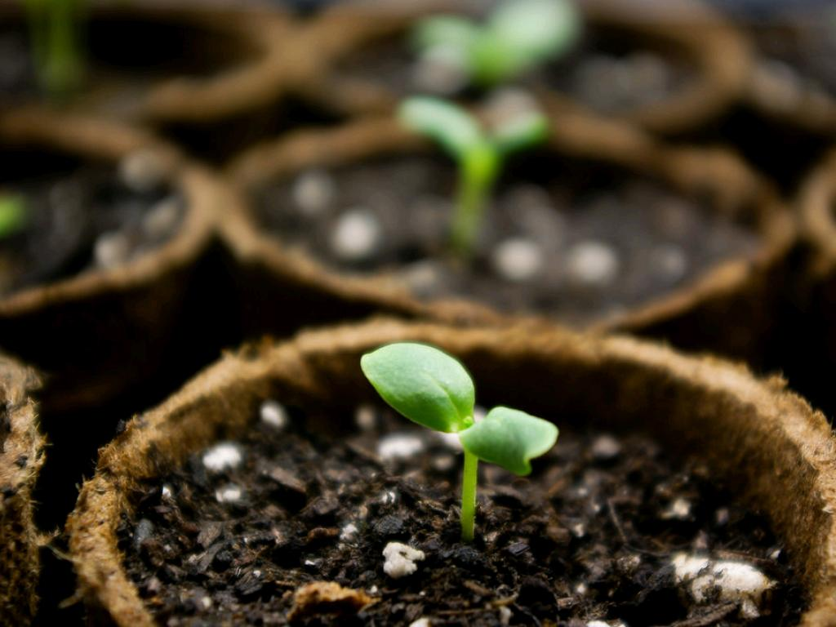
Invested
Wants to see you succeed
cc: Jackal of all trades - https://www.flickr.com/photos/12633750@N04

