Slide 1














CLINICAL SUPERVISION
DENISE CHOP, LCSW-C
ANGELA JACKELSKI, LMSW
CLAIRE MERINGOLO, LCSW-C

Slide 2
CLINICAL SUPERVISION IN SOCIAL WORK SETTINGS
Clinical supervision explores what the practitioner is thinking, feeling, and holding in their work.
It helps practitioners understand how personal experiences, unconscious responses, and emotional triggers may impact client interactions.
It helps practitioners navigate ethical dilemmas, role confusion, and identity development.
Clinical supervision explicitly addresses the impact of trauma exposure on the practitioner.
It normalizes and supports processing secondary trauma, burnout, and the emotional cost of caring work.

Slide 3


Clinical supervision doesn’t just ask, “Are you doing the work?” It asks, “How is this work shaping who you are as a social worker or clinician?”
CLINICAL SUPERVISION
ADMINISTRATIVE SUPERVISION
Reflective and Relational
Building insight, resilience, and self awareness
Trauma Informed and Developmental
Supervisor encourages critical thinking as they may seek to understand decision making process
Seeks to understand gut reaction
Task completion, Logistics
Supervisor may offer the solutions and next steps first
Ensures Accountability and Efficacy
Offers the knowledge to the supervisee rather than asking supervisee
Directive and Evaluative relationship

Slide 4
SELF CARE AND SUPERVISION
Supervision supports self-care:
Brave Space to reflect to interactions, traumatic events
Prevents compassion fatigue and burnout
Supervision supports a plan to engage in self-care outside supervision:
Self Care Plans which can include: sleep, hobbies, therapy, boundaries
Supervision is professional self-care and personal self-care is life balance
Holds the space for the social worker while they hold space for the family or community

Slide 5


HOW SUPERVISION SUPPORTS SELF-CARE
01
02
03
Creating space and mutuality in emotionally demanding work
•Helps recognize signs of burnout or compassion fatigue and buffering against those signs
Reinforcing critical thinking and identity and space to provide feedback through exploration and validation
04
05
06
Explores and models healthy boundaries and support
•Encourages reflection on emotional impact through relational connection
Helps understand Agency policy and practice through promotion of learning

Slide 6





Slow Down to critically think through pausing with supervisor and supervisee through exploring interactions, decisions, and emotional responses
“How did it affect me?”
It mirrors trauma-informed practice: safety, trust, and emotional regulation are practiced, not just taught.
REFLECTIVE PROCESS
IN
SUPERVISION
Exploring self in the work through examining one’s own values, experiences, emotions
“What am I bringing to the interaction?”
•Encourages non-defensive exploration of mistakes and successes
“Why does this dynamic feel so hard to manage?”
This parallel process reinforces attunement, containment, and relational safety.
Tools:
Supervision Forms,
Open-Ended Questions,
Self Care Plans
Feedback loops

Slide 7


CHALLENGES IN SUPERVISION
Vulnerability
You are not expected to have all the answers. Embrace the student role.
Share successes and challenges
Embracing the Learning Process
There is always something to learn, even if the learning is not what was expected.
Relationship
Partnership of TRUST. Supervison styles may differ. Learning styles may differ.
Preparedness
How can you make the most of supervision? What do you need? What are you bringing through the door?

Slide 8

CREATING A SUPERVISION AGENDA
Self-Care Check-In
How are you feeling today—personally and professionally?
What has been sustaining or draining you this week?
Client Updates
Brief updates on current caseload or key developments
Any shifts in client dynamics or engagement?
Clinical Concerns or Questions
Situations you’d like help thinking through
Treatment planning, relational stuck points, intervention strategies
Ethical Considerations
Any ethical dilemmas, boundary concerns, or questions about professional responsibilities?
Self-Awareness & Reflection
How are you noticing your own responses or emotions in the work?
Are there any personal experiences that are surfacing in parallel with your clients?
What patterns are emerging in how you’re showing up?
Professional Development Goals
What skills or areas are you currently focused on building?
Any training needs, interests, or feedback you'd like to explore?
Optional Wrap-Up Questions:
What’s one thing you’re taking away from today’s supervision?
What’s something you want to reflect on before our next session?

Slide 9
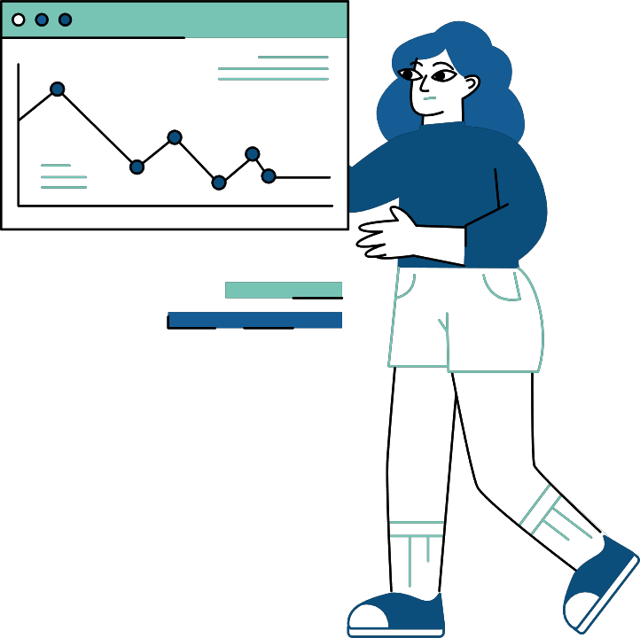
CASE SCENARIO- “WHY CAN’T I FIX THIS”?
You’re a Master’s-level social work intern placed at a child welfare agency. One of your clients is a 13-year-old girl named Kayla who has recently returned to her biological mother’s care after several years in foster care. You’ve been working closely with Kayla during family sessions and feel very connected to her. Over the past few weeks, you’ve noticed Kayla seems withdrawn. Her mom has missed two sessions, and when you ask how things are going at home, Kayla shrugs and says, “It’s fine,” but seems guarded. You feel helpless and worried—and frustrated that your supervisor hasn’t done more. You’ve found yourself thinking about Kayla even after hours and dreaming about your own childhood.
REFLECT, PAIR, SHARE
Take a few minutes to reflect on this scenario above
Work together to create a Supervision Agenda using the previous Agenda Slide

Slide 10
SUMMARY AND TAKEAWAYS
• Clinical supervision is supportive, reflective, and growth-focused
• It is a key component of professional self-care
• Enhances ethical practice, resilience, and insight
• Use supervision intentionally: prepare, reflect, engage honestly

Slide 11
THANK YOU VERY MUCH!

