Slide 1
Training Human Service Providers to Address the Complex Financial Concerns of Clients
Evaluation of the Financial Stability Pathway
Provider Project
Council on Social Work Education
October 25 , 2014

Slide 2

Baltimore City
One in four individuals lives below the poverty line (US Census Bureau)
  37% of children in poverty (AECF Kids Count 2011)
One in four households receives food stamps, and 83% of children enrolled in the Baltimore City Public School system qualify for free or reduced-price meals (Baltimore Sun).
20% of households in MD lack enough savings to survive for three months at the poverty level. This is 2X higher for HH of color. (CFED Asset & Opportunity Scorecard).

Slide 3
Research Objective
Evaluate Maryland CASH Campaign’s Financial Stability Pathway (FSP) training for providers in 8 human service organizations located within and around Baltimore City (6 non-profits and 2 Employee Assistance Programs, EAPs).
Notes:
*Focus on Objective 1 for this presentation
*Note the inclusion of EAPs – workplace counseling and consultation services for employers, employees and often their family members.
Even though people are employed, still struggling with significant and often complex financial problems that affect working adults as well as unemployed or underemployed individuals and families.
Financial concerns among employees are an increasing concern for employers as they contribute to increased employee stress and reduced productivity.

Slide 4
Maryland CASH Campaign
CASH stands for Creating Assets, Savings and Hope.
Statewide network dedicated to improving the financial security of working families.
  Capacity Building and Training
  Financial education (Maryland CASH Academy)
  Research and Advocacy
More information: www.mdcash.org
…Asset Building Continuum

Slide 5
Asset Building Continuum
Emergency & Transitional services
Financial stability
Short-term asset ownership
Long-term wealth creation
Financial education
Benefits screening
Case management & referrals
Counseling
Income supports
Financial education
Financial coaching & credit counseling
Free tax prep (VITA)
Pro bono legal counsel
Family Self-Sufficiency
Financial education & coaching
Car ownership
IDAs (computers, security deposit)
Entrepreneurship
Financial coaching
Housing counseling
Investment clubs
Retirement planning
Small business development
Programs
Utility discounts
No fee/low fee checking/savings
Second chance checking
State ID or driver’s license
Subsidized health insurance
Discount prescriptions
Credit builder loans
Debt consolidation
Loan refinance/Short-term loans
Matched Savings Accounts
Auto build CDs
Ways to Work vouchers
Affordable car loans
Financial aid for higher ed.
Insurance – car, rental, property, life
Down payment assistance
401(k), 403(b), IRAs
College Savings Plans
Insurance – car, rental, property, life
Products
Expansion of income limits (benefit cliffs)
Expansion of asset limits
Improve Check cashing regulations
Debt management and settlement protections
Refund anticipation loan/payday loan reform
Rent to own disclosures
Auto insurance pricing
Matched account funding
Funding for microenterprise programs
Product quality protection
Credit reporting standards
Predatory lending protections
Foreclosure prevention
Preserving individual right
Identity theft protection
Policies
Initial employment Continuous employment Career development and mobility
Copyright Job Opportunities Task Force (Maryland CASH Campaign) 2008
…Need for Research

Slide 6
The Financial Stability Pathway Project connects low to moderate income clients to:
Free Tax Preparation
Financial Education
Financial Coaching
Certified Credit Counseling
Budget Counseling
Benefit Screening
Access to Financial Products
…Partners

Slide 7
MD CASH Training and Infrastructure
Designed and built a Baltimore Local Page that included unique Smart Referral© Technology
Developed specialized training on the basics of financial social work, service details and the use of new technology
  Delivered 601 total training hours to 82 practitioners
Engaged research entity for evaluation
…Practitioner’s Role

Slide 8
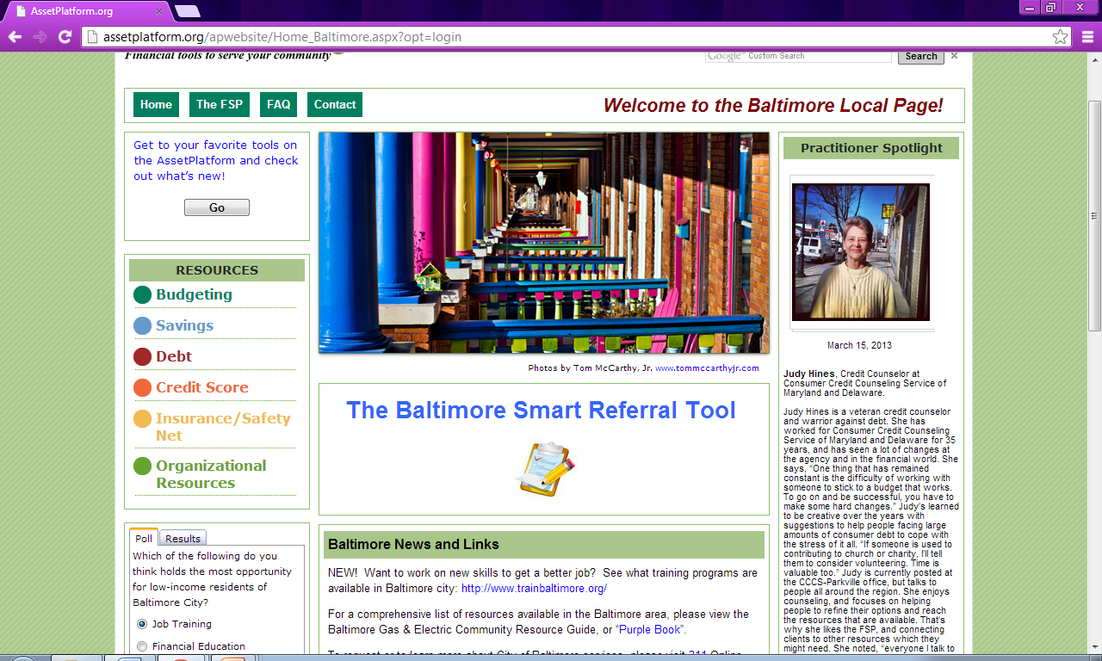
FSP

Slide 9
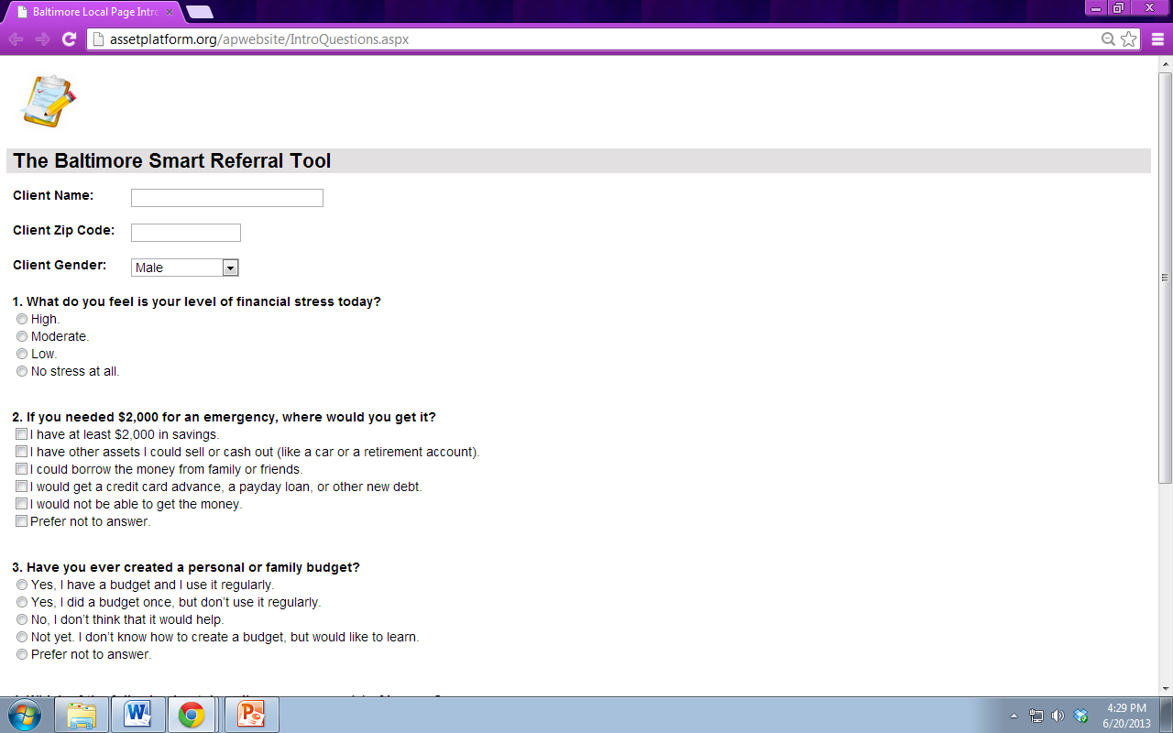
Smart Referral Tool©
Designed to be used in 10 minutes or less
Outputs:
  financial goal
  referral service information
  one-pager (can also email)
About 38% of respondents chose “Not yet. I don’t know how to create a budget but I’d like to learn.”
…The Smart Referral

Slide 10
Practitioner’s Role
Practitioners should not give financial advice, investment tips, or provide referrals to brokers. In short, not financial planners.
Practitioners currently help clients create budgets, manage benefits, and sometimes manage their finances (representative payees).
Practitioners can help clients work through the psychosocial side of financial management.

Slide 11
Psychosocial Side of Financial Management
Reflecting on own biases
Asking questions without judgment
Money is emotional, staying with the client where they are
Use tools to help ask directive questions
Need to be familiar with types of financial assistance programs and resources within the community

Slide 12
Financial Stability Pathway Training for Providers: Overview
Financial stability
Use of Maryland CASH Smart Referral Tool on the Baltimore City Local Page of the Asset Platform (Aspen Institute)
Assessment of financial problems
Help individuals and families manage: 1) current financial situations; 2) improve future financial outlook; 3) address emotional concerns & problems related to finances
Monthly consultation and meetings with researchers and Maryland CASH staff
Notes:
Training focused on key components of financial social work, FSP project and Asset Platform/ Baltimore local page

Slide 13
Methods
Provider Study:
  One group, longitudinal research design
  Pre-test, post-test (immediately after training), and follow-up (9 months) online surveys
  Outcomes: providers’ knowledge, self-efficacy and practice behaviors
Notes:
*Focus on provider study methods for this presentation

Slide 14
Measures: Provider Survey
Pretest: 7 sections to survey + open-ended questions
  Baseline understanding of providers’ financial knowledge,
  Confidence to work with clients on financial problems,
  Practice behaviors
  Own financial behaviors
Post-Test -- immediately following training
Follow-Up -- 9 months after training

Slide 15
Measures for Providers (continued)
Section I: demographics and professional experience
Section II: prior education on financial capability
Section III: work setting and client practice behaviors
Section IV: perceived preparedness to deliver financial services to clients within work setting
Section V: financial well-being assessed using the Personal Financial Wellness Scale (PFW; Prawitz et al, 2006).
Notes:
Client practice behaviors – developed from FSP training ---
initiation of conversation with clients,
assessing resources,
discussing values and beliefs, ST and LT goals, referrals, financial choices
PFW – 10-point scale (1=most overwhelming stress and 10=no financial distress)

Slide 16
Measures for Providers (continued)
Section VI: personal financial knowledge
  assessed using 3 indices (credit, savings, and other financial topics)
  from the University of Michigan’s quiz, “What’s Your Financial IQ,” part of the broader national study, Survey of Consumers (Hilgert et al., 2003)
Section VII: financial behaviors assessed using the Financial Management Behavior Scale-Revised (FMBS; Dew & Xiao, 2011)
Notes:
All measures were statistically reliable for the study with reliable coefficient ranging from very good to excellent
Section VII:
18 item scale
15 items – financial behaviors in past 6 months – ranges never to always (5-point scale)
3 items – insurance (health, life, property/auto) – ranges never to always
Open-Ended Questions (asked at T3)
Example of how you used knowledge and skills with clients
Suggestions to improve training
Suggestions to improve online tool

Slide 17
Results
Section I: Sample Description
Final N=24 (57% overall response rate)
Majority (72%) female
53% White, 31% Black, 9% Hispanic
60% Master’s degree or higher
Age: M=45.1 years (range=26-67)
Experience: M=15 years (range=1-45)
Current Employer: M=7.5 years (range 1-34)
Note: M = mean or average
Notes:
At T1: sample included 15 EAP participants and 16 non-profit participants = 31

Slide 18
Results
Section II: Education and Training
Majority (70%) reported prior training or education
Majority (62.5%) reported completing additional training at follow-up
  managing personal finances
  behavioral economics
  financial counseling / coaching
  financial products
  financial values and habits
Notes:
Prior training – managing personal finances, financial produces, credit, financial counseling and coaching
Goal was realized (intended outcome was for providers to seek more training)- providers wanted more training in addition to what they received about FSW and FSP and actually completed advanced and/or specialized training by the time of the follow-up

Slide 19
Results
Section III: Providers’ Work Settings and Practice Behaviors with Clients
Majority of providers’ clients are concerned about not having enough income to cover expenses (84.4%, at training and 91.7% at follow-up)
  This is not just a problem among poor and unemployed individuals – significant number of clients seen in Employee Assistance Programs
Notes:
Other Client Concerns
Credit card/consumer debt
Unpaid housing bills
General personal financial stress
Counselors in study spent about 50% of face-to-face time with clients on financial issues
Active learning was a goal of FSP training and program and achieved

Slide 20
Section III: Providers’ Work Settings and Practice Behaviors with Clients
Almost all providers reported participating in activities to continue learning from FSP training
  reviewing materials and recommended articles and websites
  seeking additional training on financial issues relevant to their clients
  participating in monthly FSP site conference calls

Slide 21
Results
Section III: Providers’ Work Settings and Practice Behaviors with Clients
Financial practice behaviors learned in training significantly improved between T1 and T3
  How often providers addressed clients’ value systems and beliefs around money and finances
  Discussed financial choices with clients
  Helped set both short-term and long-term financial goals
  Discussed behavior change around finances
Notes:
Very encouraging finding – training often results in good intentions, but poor uptake or sustainability of new skills at follow-up
Use of monthly consultation (i.e. booster sessions) may have helped (not measured in current study – sample was too small to tease this out)
Overall, counselors were satisfied with the training, online tools, & pleased with ease of enrolling clients into FSP program

Slide 22
Results
Section III: Providers’ Work Settings and Practice Behaviors with Clients
One participant commented:
  “A client had difficulty paying her debts and to refrain from spending on things which she ‘might need’ in the future. I used the Money Habitudes cards to help her understand her relationship with money and material goods, and then set up some goals with her to begin to be more conscious of her spending habits and to begin saving money, while paying down her debts”

Slide 23
Results
Section IV: Perceived Preparedness to Deliver Financial Services to Clients
Participants overall self-efficacy and confidence improved after the FSP training and at follow-up nine months later
  especially in navigating and using FSP online tools
  knowing where to refer clients for additional financial services. For example,
  “One thing that has improved since the FSP training is the ability to refer people to partner organizations, since I have met the service providers there.”
Notes:
Confidence / Self-Efficacy
Specific items on scale that were significant included:
knowledge where to refer clients for financial services not available through agency
knowledge to navigate FSP tools to help clients achieve goals
Additional Questions at T3
Confidence (scale from 1-5)
Knowledge of financial referrals in Baltimore, M=3.04
Confidence in financial services recommended by FSP, M=3.21
Confidence in financial products recommended by FSP, M=3.05

Slide 24
Results
Sections V & VI: Personal Well-Being and
Financial Knowledge
Scores on the Personal Financial Wellness Scale (PWS) did not significantly change over time
Knowledge measures for credit, savings, and other financial knowledge did not significantly change over time
Some items had high correct percentages (80% or higher) at T1; therefore, not much room to improve on
Notes:
Participants were already quite knowledgeable, so many responses were correct at T1

Slide 25
Results
Section VII: Personal Financial Behaviors
While no significant changes across evaluation period, providers reported being consistently engaged in “good” or “desired” personal financial practice behaviors ---
  paying bills on time
  keeping a record of expenses
  saving money
  contributing to a retirement account
  purchasing or maintaining adequate insurance
Notes:
At T1, behaviors were already good and desired – little opportunity for movement

Slide 26
Summary of Results from Standardized Measures and Scales
Measure | Score Range | Time 1 Mean(SD) | Time 2 Mean(SD) | Time 3 Mean(SD)
Financial Practice Behaviors* | 1-5 | 2.79 (1.03) | NA | 3.09 (0.81)
Confidence & Self-Efficacy* (1/2, 1/3) | 1-4 | 2.86 (.60) | 3.21 (0.39) | 3.12 (0.59)
Personal Financial Wellness (PFW) | 1-10 | 6.79 (2.01) | 7.01 (2.15) | 7.08 (2.07)
Financial Management Behavior Scale (FMBS) Total† | 1-5 | 3.69 (0.59) | NA | 3.81 (0.52)
FMBS Cash Management | 1-5 | 4.11 (0.73) | NA | 4.17 (0.54)
FMBS Credit Management | 1-5 | 2.29 (0.52) | NA | 2.31 (0.56)
FMBS Savings/Investment | 1-5 | 3.64 (1.03) | NA | 3.86 (0.99)
FMBS Insurance* | 1-5 | 4.59 (0.95) | NA | 4.71 (0.73)
Financial Knowledge | 0-100% | 71.9% | 72.5% | 76.3%
†p<.10, *p<.05

Slide 27
Discussion
Strengths
  New area of research within human service field
  Results set a benchmark for future studies
  Longitudinal design used
  Survey developed by experts and measures were reliable
Limitations
  Small sample – difficult to generalize
  Lack of a control group
  Reliance on self-report measures
  Drop off in response rate 9 months later (T3)

Slide 28
Thank you!
Thank you!
Karen Hopkins, PhD khopkins@ssw.umaryland.edu
Philip Osteen, PhD posteen@fsu.edu
Christine Callahan, PhD ccallahan@ssw.umaryland.edu

Slide 29
Acknowledgements and Research Team
  This study was funded by the Maryland CASH Campaign, c/o the Job Opportunities Task Force, working in collaboration with the Aspen Institute and the University of Wisconsin Center for Financial Security
  Research Team Members:
  Jodi Jacobson Frey, PhD: Principal Investigator
  Karen Hopkins, PhD: Co-Principal Investigator
  Philip Osteen, PhD: Co-Principal Investigator
  Lara Henneman, MA: Project Manager
  Jungyai Ko, MSSW: Research Assistant
  Lucy Bill, MSW: Research Assistant

Slide 30
References
Birkenmaier, J., Sherraden, M., & Curley, J. (Eds.) (2013). Financial capability and asset development: Research, Education, Policy and Practice. New York, NY: Oxford.
Dew, J., & Xiao, J. J. (2011). The Financial Management Behavior Scale: Development and Validation. Journal of Financial Counseling and Planning, 22, 43-59.
Hernandez, M. T. & Karger, H. J. (2004). The decline of the public intellectual in social work. Journal of Sociology and Social Welfare, 31(3), 51-68.
Hilgert, M. A., Hogarth, J. M., & Beverly, S. G. (2003). Household financial management: The connection between knowledge and behavior. Federal Reserve Bulletin, 89, 309-322.
Sherraden, M., Laux, S., & Kaufman, C. (2007). Financial education for social workers. Journal of Community Practice, 15(3), 9-36.
Prawitz, A. D., Garman, E. T., Sorhaindo, B., O’Neill, B., Kim, J., & Drentea, P. (2006). The InCharge Financial Distress/Financial Well-Being Scale: Development, administration, and score interpretation. Financial Counseling and Planning, 17(1), 34-50.

