Slide 1
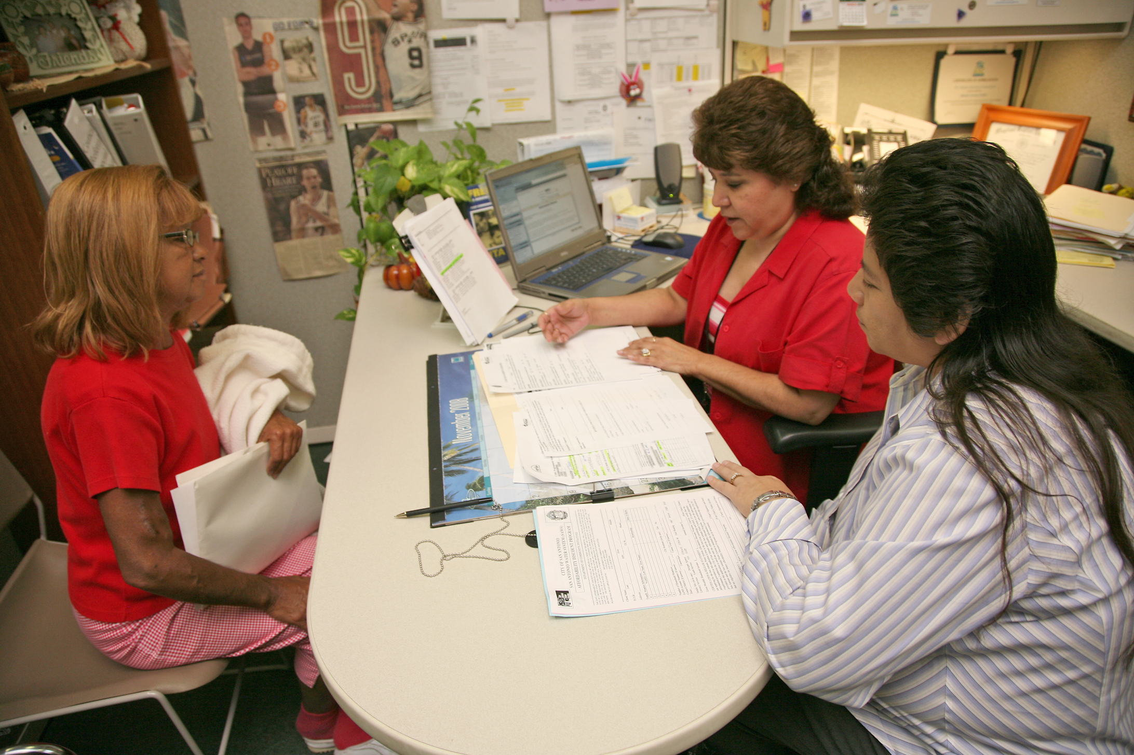
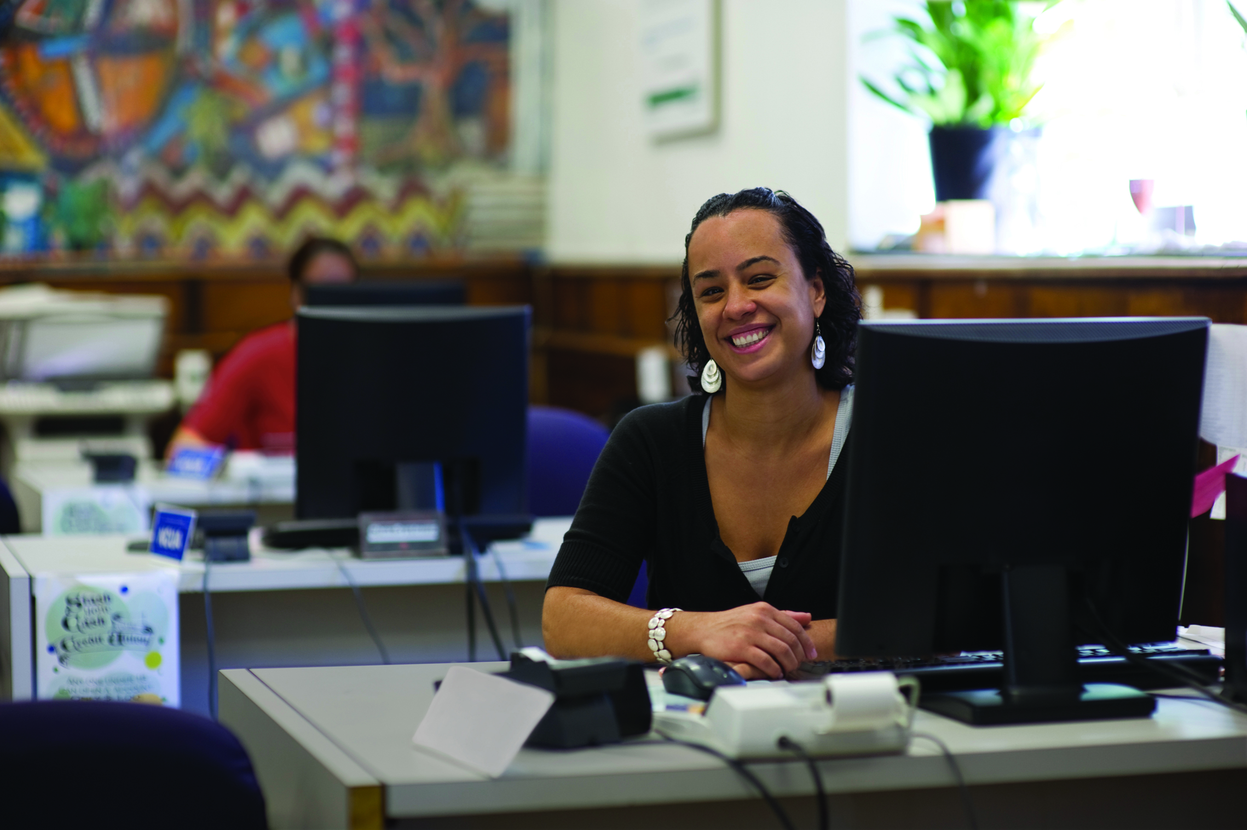
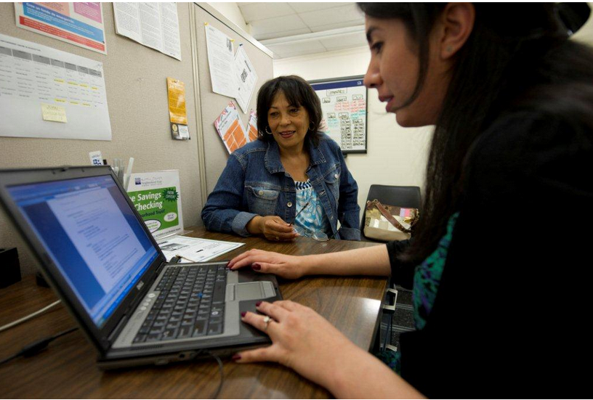
Bridging the Gap: Making the Case for Financial Empowerment
in Family and Community Stability
University of Maryland School of Social Work
March 9, 2018

Slide 2
the real world (a.k.a. after graduation):
with experience and wisdom …
busted myths

Slide 3
The National Myth
The economic recovery is largely complete; the nonprofit sector can take care of the stragglers.

Slide 4
Asset poverty is so prevalent … it’s becoming the norm
    Nearly half of households in this country don’t have the assets to survive three months without their income and live above the federal poverty rate (43%).
    Almost 1-in-5 households either have zero wealth, or “negative net worth” (debts greater than their assets) (17%).
    Almost 25% of US consumers are so significantly behind that they have at least one debt in collections.
    65 million adults in the US are un- or underbanked, relying on costly alternative financial services outside of the financial mainstream for routine financial transactions (such as check cashers, payday lenders, and pawn shops).

Slide 5
Local government well situated to succeed
    Public accountability
    Access
    Power
    Scale

Slide 6
The rise of
“Municipal Financial Empowerment”
High quality financial counseling and education
Access to safe and affordable banking
Savings and asset building
Consumer financial protections

Slide 7
The Asset Building Field Myths
    The only way to reduce debt is to grow income.
    Poor people can’t save … first things first.
    Mainstream banking is old-fashioned.

Slide 8
DEBT can be reduced
People making an average of only $21,000 per year
…with an average of nearly $29,000 in debt (e.g. credit cards, utility debt, student loans)
…when working with a professional financial counselor 1-on-1
…were able to reduce their debt by at least 10%
…72.4% of the time.
In fact, across all 6 operating Financial Empowerment Center city programs, 80,000 clients have reduced a total of $95 million in personal debt.

Slide 9
SAVINGS are possible
Those same clients making only $21,000 a year?
Over 60% increased their credit score … by over 35 points
And 52% of them increased their savings … by at least a week’s worth of their salary
And across all 6 Financial Empowerment Center cities, clients have already saved over $12 million in less than 8 years.
Also, national SaveUSA pilot and evaluation: people respond to matched savings opportunities.

Slide 10
BANKING matters
Those who are unbanked are generally in worse shape to start. They:
  … are half as likely to live in a place of their own
  … have half the income of those who are banked
  … are half as likely to be able to come up with $500 in an emergency (in fact, have just 5% of the savings that those who are banked have)
  … have almost one third lower credit scores than the banked (avg. 361 vs. 507)
The unbanked are in a worse position to improve, even working repeatedly with professional counselors one-on-one:
  … are less than half as likely to be able to increase their savings
  … are over a third less likely to be able to establish a new credit score

Slide 11
The Social Work Myth
Case workers don’t wade into personal finance; it isn’t part of social work.

Slide 12
The social work field gave birth to financial empowerment!
Reducing the impact … and incidence … of poverty has been central to social work practice since the birth of the profession (Addams, 1910; Franklin, 1986)
Social work scholar and educator Michael Sherraden is considered the “father of asset building”, first and famously suggesting that assets, not just income, have positive effects on well-being and future orientation.

Slide 13
Poverty and …
Success at Work
Stress
Marriage
Parenting
Crime and Recidivism
Health
Success at School

Slide 14
The “Supervitamin Effect”
Programmatic integrations that measure the impact of professional financial counseling on host social service programs.
    Returning citizen programs
    Workforce
    Domestic Violence
    Housing

Slide 15
www.CFEfund.org

