Slide 1
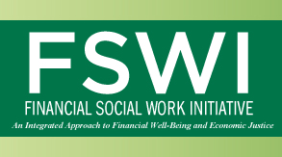
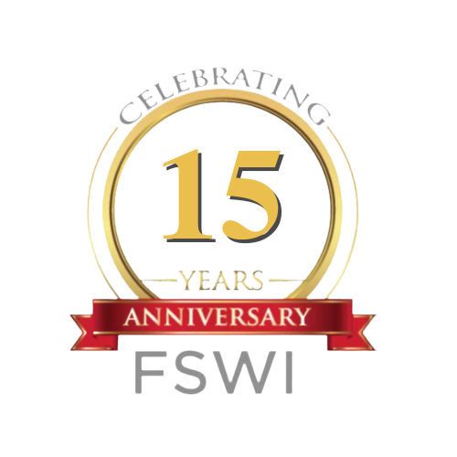
Prioritizing Our Women’s Economic Rise (POWER) Collaborative
Christine Callahan, PhD, LCSW-C/Research Associate Professor
Chair, UMSSW’s Financial Social Work Initiative (FSWI)

Slide 2
What is POWER All About?
Prioritizing Our Women’s Economic Rise is a three-year project supported by JPMorgan Chase that brings together community-based organizations, government agencies, and institutions to accelerate the wealth creation among Black and Latina women in Baltimore:
  Latino Economic Development Center (LEDC) and LEDC Lending
  Empowered Women International (an LEDC program)
  Baltimore City Lending
  Black Women Build Baltimore
  Byte Back
  Parity
  Baltimore DC Building and Trades
  VPI
The POWER project equips Black and Latina women with the tools (Skills Training, Entrepreneurship Education, Access to Capital, Financial Education) to tap into the emerging and existing economic opportunities for the redevelopment and revitalization of the city of Baltimore.
This project also includes advocacy for equitable and inclusive implementation of the state and local initiatives to address issues of the acquisition and disposition of vacant properties in Baltimore. Moreover, through other trainings and support, it helps women interested in building their own small businesses to do so. That entrepreneurial element is present, too.

Slide 3
Discussion Questions
How are you using research in your practice as related to the topic discussed?
What other resources do you need to implement research informed practice?
What are you looking for with research to help improve your practice in the future? What can you do to connect more with the SSW/Lab on research?

