Slide 1
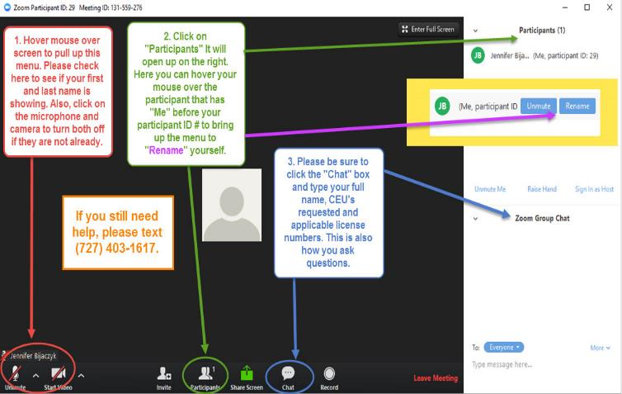

Welcome to the FTA Webinar
Your Name
If you still need help, please call
(609) 269-2390
Your Name

Slide 2
Welcome to the FTA Webinar
The Ongoing Financial Impact of
COVID-19: How to Help Your Clients Find Surer Financial Footing
Friday, August 7, 2020
1:00 pm – 2:00 p.m. EST
Sponsored by
The Financial Therapy Association
www.FinancialTherapyAssociation.org
**This webinar is being recorded**

Slide 3
Details of our Webinar
Webinar Host is Sarah Swantner, MS, CFP®, NCC, a practicing financial therapist and President-Elect of the FTA Board of Directors.
Notices
FTA thanks the presenter of this webinar. Information presented reflects the personal knowledge and opinions of the presenter and does not necessarily represent the position the FTA.

Slide 4
COURTESY
All participants have been muted for voice and video.
Please keep yourself muted throughout the entire presentation.
Please ask questions in the chat box throughout the presentation.
We will address questions throughout the presentation.
We are taking attendance!
Please write your full name, CEUs requested and license number in the chat box

Slide 5
FTA’s Mission
The Financial Therapy Association (FTA) is an organization comprised of professionals dedicated to the integration of cognitive, emotional, behavioral, relational, and financial aspects of well-being.
The FTA exists to unite professionals from multiple disciplinary backgrounds:
  To create a new profession of financial therapy,
  To disseminate cutting edge research,
  Establish best practices,
  Provide training that enhances client quality of life, and
  To shape public policy and practice management standards within financial therapy.

Slide 6

Interested in sponsoring?
Contact us today: admin@financialtherapyassociation.org

Slide 7
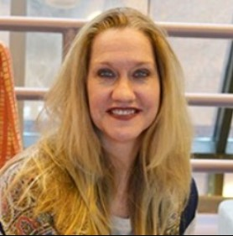
Today’s Presenter
Christine Callahan, Ph.D., LCSW-C

Slide 8
THE ONGOING FINANCIAL IMPACT OF COVID-19: HOW TO HELP YOUR CLIENTS FIND SURER FINANCIAL FOOTING
Christine Callahan, PhD, LCSW-C
Research Associate Professor
University of Maryland School of Social Work
Financial Social Work Initiative

Slide 9
FINANCIAL SOCIAL WORK INITIATIVE AT THE UNIVERSITY OF MARYLAND SCHOOL OF SOCIAL WORK
Founded in 2008
Research, training, policy and practice advocacy in the areas of financial capability and financial empowerment
Focus on vulnerable populations and communities

Slide 10
OVERVIEW OF FINANCIAL CHALLENGES DURING PANDEMIC
Drastic loss of work and income
Workers on the front lines
Hourly workers
Self-employed; gig workers
Telework challenges and changes
Stress and balance with child care and school responsibilities
Housing instability; now looming evictions

Slide 11
IMPACT OF COVID-19 ON PEOPLE AND COMMUNITIES OF COLOR
Health and economic impacts are especially profound
Systemic racism and inequality and poverty ravage communities of color
Workers are more frequently on the front lines and exposed

Slide 12
INTERSECTIONS WITH OTHER PSYCHOSOCIAL STRESSORS
Intimate Partner Violence Amid Stay-at-Home
  Heightened stress and financial distress and abuse
Older Adults
Pre-existing Conditions

Slide 13
INTERVENTIONS
Unemployment Insurance (UI)
Pandemic Unemployment Assistance and Other Legislation
Economic Stimulus Checks
Financial Crisis Counseling
Connection with Critical Resources

Slide 14
POSSIBLE INTERVENTIONS/ TECHNIQUES
Motivational Interviewing
  Pros and cons of each spending choice
Quantify/Use tangible examples
  Mental accounting
  Probability discounting
Open-ended questions

Slide 15
OTHER TOOLS TO AID INTERVENTIONS
“What's your money story?"
The importance of contingency planning/mitigating risk

Slide 16
PROGRAMS AND RESOURCES
Unemployment: https://www.dol.gov/coronavirus/unemployment-insurance
IRS: https://www.irs.gov/newsroom/economic-impact-payments-what-you-need-to-know
Consumer Financial Protection Bureau: https://www.consumerfinance.gov/
Prosperity Now:
https://prosperitynow.org/resources/covid-19-resources

Slide 17
STIMULUS CHECKS: SCREENING FORM & NEEDS ASSESSMENT
Using it as a template/interview guide

Slide 18
STIMULUS CHECKS: SCREENING FORM & NEEDS ASSESSMENT
Contextual adaptations
  External local resources
  Clinical documentation and other internal resources

Slide 19
QUESTIONS?

Slide 20
THANK YOU!
Christine Callahan, PhD, LCSW-C; ccallahan@ssw.umaryland.edu and fsw@ssw.umaryland.edu

Slide 21
Thank you for attending!
FTA will submit for CFP® CEUs
AFC® and Mental Health are self-report for CEUs
All webinars are recorded and uploaded to the FTA Website.
You can register to view any past webinars you missed for a small registration fee.
Visit the FTA website at www.FinancialTherapyAssociation.org
Please join FTA!

