Slide 1
the costs of cancer: addressing patient costs
2018 Illinois cancer symposium
Christine Callahan, PhD, LCSW-C
Research Assistant Professor
University of Maryland School of Social Work/Financial Social Work Initiative

Slide 2
Some background…
Oncology social worker for 20+ years at the NIH Clinical Center
Financial quality of life study for PhD dissertation
Experience in professional and personal realms with cancer
Research and education now on financial capability

Slide 3
Learning objectives for this session
Examine costs of cancer treatment and how this affects people with cancer
Understand specific details on the financial burden borne by patients with cancer
Appreciate costs from patient point of view

Slide 4

Information sources
American Cancer Society Cancer Action Network (ACS CAN): The Costs of Cancer (2017) Report
Scholarly and policy literature on financial burden faced by patients with cancer
Clinical experiences

Slide 5

Total U.S. EXPENDITURES for cancer BY SOURCE OF PAYMENT-2014
44% private insurance
33% Medicare
15% Other
4% Medicaid
4% Patient Out-of-Pocket Costs = $3.9 billion
TOTALING $87.8 BILLION
Source: Medical Expenditure
Panel Survey (MEPS)

Slide 6
TOTAL U.S. EXPENDITURES for cancer BY TYPE OF SERVICE-2014
58% Hospital Outpatient or Office-Based Provider Visits
27% Hospital Inpatient Stay
12% Prescribed Medicines
2% Home Health
1% ER visits
Source: MEPS

Slide 7
Costs contributing to care
Nature of insurance coverage and type of plan
Public or private?
Associated costs, e.g., premium, deductible, co-pays, caps
Supportive medicines and those costs
In-network or out of network?
Balance billing

Slide 8

Other important contributors
Treatment plan
Geographical location
Treatment setting
Health disparities

Slide 9

Indirect costs – significant!
Impact of work and income
Benefits – present or not?
Hourly wage workers; spikes and dips in income
Transportation, parking, and fuel
Housing
Child care
Juggling multiple responsibilities, financial and otherwise
Attending to other medical and psychosocial needs

Slide 10
Related financial factors
Level of pre-existing debt
Assets
Wage-earner(s) in household and amount of income
Low-income workers
Objective and subjective levels of financial distress
Nat’l Cancer Institute, “Financial Toxicity
And Cancer Treatment”

Slide 11
Emotional impact
Dealing with feelings around the cancer diagnosis and “existential plight”
Feelings of being overwhelmed
Feelings of hopelessness
Prioritizing responsibilities and costs, but often neglecting one(s) for another
At risk for depression, anxiety, and other conditions
Presence of other simultaneous psychosocial stressors?

Slide 12
Patient profile 1(breast cancer)
See hand-out

Slide 13
Patient profile 2 (lung cancer)
See hand-out

Slide 14
Patient costs for BCA by type of insurance
EMPLOYER
Total: $5,819
$3,475 co-pays & co-insurance
$500 deductible
INDIVIDUAL PLAN
Total: $10,114
$6,850 co-pays & co-insurance
MEDICARE
Total: $8,793
$1,589 co-pays & co-insurance
$4,978 Medigap premiums
$1,844 premiums
$3,264 Premiums
$766 Medicare Part D premiums
$1,462 Medicare Part B Premiums

Slide 15
PATIENT COSTS FOR LUNG CA BY TYPE OF INSURANCE
EMPLOYER
Total: $5,654
$3,310 co-pays & co-insurance
$500 deductible
INDIVIDUAL PLAN
Total: $10,114
MEDICARE
Total: $8,396
$1,192 co-pays & co-insurance
$766 Medicare Part D premiums
$1,844 premiums
$3,264 Premiums
$4,978 Medigap premiums
$1,462 Medicare Part B premiums
$6,850 co-pays & co-insurance

Slide 16
Key findings
Type of insurance coverage is critical, and employer-based tends to be more generous
Out-of-pocket limits help protect patients
Costs vary widely
Type of treatment costs vary as well

Slide 17

Other findings
Cancer costs tend to be front-loaded and highest towards the beginning of care
Medigap makes costs more consistent
Timing also matters (yet often is beyond one’s control)

Slide 18

Compounding factors
Out-of-network charges
High Deductible Health Plans
Non-covered treatments or changes in coverage
Denials
Lack of coverage

Slide 19

NAVIGATING THE MAZE
Toll on physical and emotional energy
Difficulty absorbing information
Difficulty advocating for oneself, especially if social support is minimal
Decision-making challenges

Slide 20

What else helps?
Open, honest communication with the patient and family
Team approach and utilizing expertise of all disciplines involved, e.g., medicine, pharmacy, nursing, social work, etc.
Financial navigators and link with financial toxicity

Slide 21
Financial navigation in oncology (and other medical) settings
Seeking out patients pro-actively (instead of working solely with uninsured patients or those asking for assistance)
Reviewing and verifying all new patients’ insurance status
Communicating with the patient about their insurance status, coverage as it relates to their tx plan, and expected cost of tx
Using tools to evaluate financial toxicity
Completing insurance optimization to identify the best insurance for each patient’s needs, including applying for primary and secondary insurance
Assisting patients in accessing financial resources
MI Cancer Consortium, Financial Navigation for People
Undergoing Cancer Treatment, 2/2018

Slide 22
Financial navigation in oncology (and other medical) settings
Completing paperwork for patients in applications for additional insurance, payment assistance, or drug assistance programs
Connecting patients to other available social and financial supports
Creating payment plans with patients
Sharing payment plans with team, including clinic check-in staff who may be responsible for collecting co-pays
Monitoring for potential new patients by noting insurance changes and working with accounts receivable, especially monitoring patients who miss payments
MI Cancer Consortium, Financial Navigation for People
Undergoing Cancer Treatment, 2/2018

Slide 23
COmprehensive Score for Financial Toxicity (COST)- Items 1, 6, 7 and 11 should be
reverse scored, as higher scores indicate higher distress. (de Sousa et al., 2017)
0 – Not at all
1 – A little bit
2 – Somewhat
3 – Quite a bit
4 – Very much

Slide 25
Intersection with the financial
Recognizing that financial distress is prevalent, especially since the Great Recession
Medical illness is the number-one reason for declaring bankruptcy
Millions of Americans live without emergency savings or do not have the resources to manage for 3 months if faced with an emergency (Nat’l Financial Capability Survey, 2012)
Financial stability can suffer
Living in or being at risk of living in poverty can be ever-present
Becoming familiar with resources that promote financial stability (once crisis has passed)

Slide 26
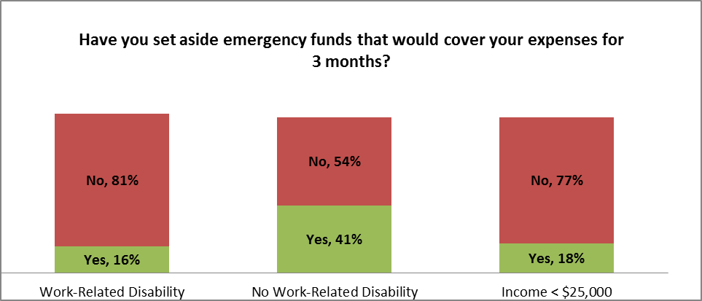
Rainy day Funds
From Nat’l Financial Capability Survey, 2012

Slide 27
Quick Facts
The American Community Survey (ACS) estimates the overall rate of people with disabilities in the US population in 2015 was 12.6% (keeps rising)
More than one in five (21.2%) US citizens with disabilities of working-age in 2015 were living in poverty; for US citizens of working-age without disabilities, the national poverty rate was 13.8%
An earnings disparity of over $10,000 in median earnings between those with and without disabilities has existed since at least 2008; the disparity has increased in magnitude since 2013.
From 2016 Disability Statistics Annual Report

Slide 28
Poverty and People with Disabilities
More than one in five (21.2%) US citizens with disabilities of working-age in 2015 were living in poverty. For US citizens of working-age without disabilities, the national poverty rate was 13.8%.
FINRA Report – Respondents with work-related disability report:
  Greater difficulty making ends meet
  Participating in less financial planning
  Poorer management of financial products
  Lower financial literacy

Slide 29
Questions patients with cancer may want to ask about treatment costs
I’m worried about how much cancer tx is going to cost me. Can we talk about it?
Will my health insurance pay for this tx? How much will I have to pay myself?
I know this will be expensive. Where can I get an idea of the total cost of the tx we’ve talked about?
Adapted from ACS, 2017; cited in
Carrera, Kantarjian, & Blinder, 2018

Slide 30

More questions for discussion with oncologist and team
If I can’t afford this tx, are there others that might cost less but will work as well?
Is there any way I can get help to pay for this treatment?
Does my health insurance company need to preapprove or precertify any part of the tx before I start?
Where will I get tx – in the hospital, your office, a clinic, or at home?

Slide 31

Policy implications
Health insurance:
  Comprehensive
  Adequate
  Affordable
  Available
  Easy to understand
  Expansion of Medicaid

Slide 32
Contact us!
UMSSW Financial Social Work Initiative at the University of Maryland School of Social Work:
www.ssw.umaryland.edu/fsw

Slide 33
references
Banegas, M.P. et al. (2018). For working-age cancer survivors, medical debt and bankruptcy create financial hardships. Health Affairs, 35(1), 54-61.
de Sousa, J.B. et al. (2014). The development of a financial toxicity patient-reported outcome in cancer: the COST measure. Cancer 120, 3245-3253.
Cancer Action Network/American Cancer Society. The Costs of Cancer: Addressing Patient Costs.
Carrera, P. M. et al. (2018). The financial burden and distress of patients with cancer: understanding and stepping-up action on the financial toxicity of cancer treatment. CA Cancer Journal for Clinicians, 68, 153-165.
Michigan Cancer Consortium. (2018). Financial navigation for people undergoing cancer treatment. Lansing, MI: Public Sector Consultants.
National Cancer Institute. Financial toxicity and cancer treatment.
Swanberg, J.E. et al. (2017). Managing cancer and employment: decisions and strategies used by breast cancer survivors employed in low-wage jobs. Journal of Psychosocial Oncology, 35(2), 180-201.

