Slide 1
LIVE Student Orientation to Practicum Education
WELCOME
Tuesday, August 19 6:00 pm to 9:00 pm
Thursday, August 21 1:00 pm to 4:00 pm
Friday, August 22 9:00 am to 12:00 pm
WE will be RECORDING The first part for attendance purposes

Slide 2
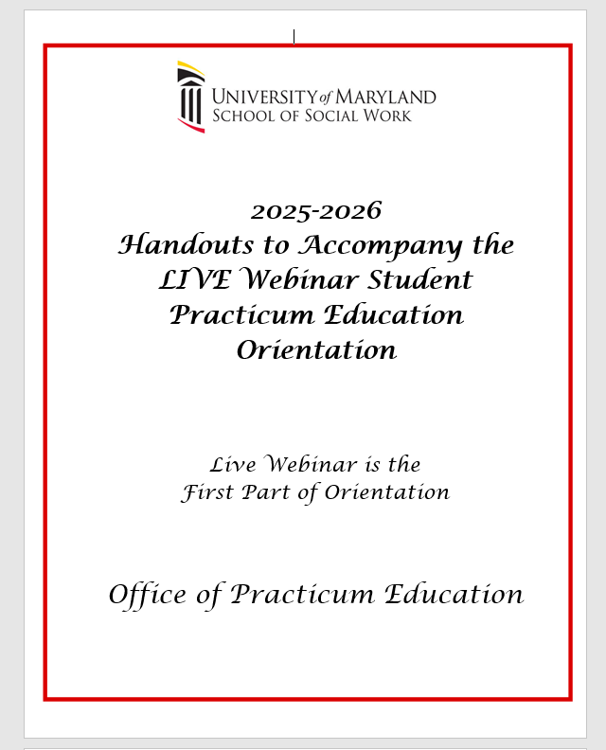
https://www.ssw.umaryland.edu/practicum/orientations/

Slide 3
Agenda
Welcome
Laura Loessner, MSW, LICSW, LCSW-C, Director, Office of Practicum Education
Meet the Office of Practicum Education
Practicum is a Course
Laura Loessner, MSW, LICSW, LCSW-C
Resources & Instructions: Safety Checklist,Certificate of Completion,Code of Conduct
Gisele Ferretto, MSW, LCSW-C, Manager of Training
Small Group Topics:
Introduce yourself to faculty and other students
Review of Individual/Clinical and Macro Process Recording Outline
Practice Activity: Process Recording
Review of Professional Code of Conduct
Practice Activity: Discussion of Scenarios

Slide 4
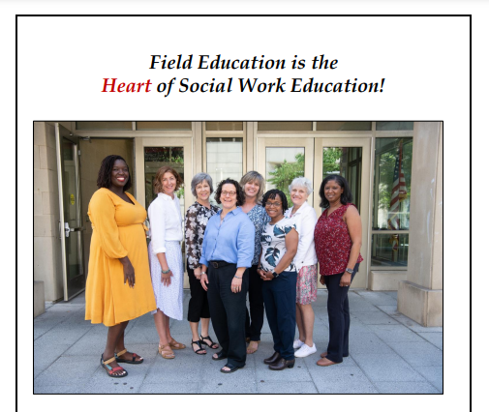
Welcome Laura Loessner, MSW, LICSW, LCSW-C
Clinical Associate Professor
Director, Practicum Education
Meet the
Office of
Practicum Education
Team

Slide 5
Laura Loessner, MSW, LCSW-C, LICSW Director of Practicum Education, Clinical Associate Professor
Donna Earling, BS, Office Manager
Esther Carlson, MSW, LCSW-C SSW Asst.Professor, Practicum Coordinator | Madge M. Henderson,MSW,LCSW-C SSW Asst. Professor, Practicum Coordinator
Denise Chop, MSW, LCSW-C SSW Assoc.Professor, Practicum Coordinator | Angela Jachelski, MSW, LMSW SSW Asst. Professor, Practicum Coordinator
Caron Cox-Branch,MSW,LCSW-C SSW Asst.Professor, Practicum Coordinator | Claire C. Meringolo, MSW,LCSW-C SSW Asst. Professor, Practicum Coordinator for the Child Welfare Fellowship Program
Gisele Ferretto, MSW, LCSW-C SSW Assoc. Professor Manager, Practicum Education Training | Rosalind Munyiri-Wilson,MSW, LCSW-C SSW Asst. Professor, Practicum Coordinator for the BHWISE Fellowship Programs
Lynn Murphy Michalopoulos, AM, PhD Director of Global Engagement, Coordinator for International Placements
Page 4 in handouts
Notes:
Here is the list of the positions at the Office of Practicum Education. You will find specific contact information in your manual and on the Practicum at a Glance handout as well as on our website.

Slide 6
Practicum is a Course Laura Loessner, MSW, LCSW-C, LICSW Director of Practicum Education Clinical Associate Professor

Slide 7
Practicum is a Course
Review FULL SSW Practicum Education Manual & Calendar for specifics
Practicum COURSES
SOWK 635 (fall) and SOWK 636 (spring) Foundation Practicum
SOWK 637 (fall) and SOWK 638 (spring) Foundation Seminar I
SWCL 794 Advanced Practicum Clinical
SWOA 794 Advanced Practicum LPSC Leadership, Policy,& Social Change

Slide 8

Council on Social Work Education 2022 Educational Policy and Accreditation Standards EPAS 9 Social Work Competencies
Pages 7-10 in handouts
https://www.cswe.org/accreditation/policies-process/2022epas/
1 | Demonstrate Ethical and Professional Behavior
2 | Advance Human Rights and Social, Racial, Economic, and Environmental Justice
3 | Engage Anti-Racism, Diversity, Equity, and Inclusion (ADEI) in Practice
4 | Engage In Practice-informed Research and Research-informed Practice
5 | Engage in Policy Practice
6 | Engage with Individuals, Families, Groups, Organizations, and Communities
7 | Assess Individuals, Families, Groups, Organizations, and Communities
8 | Intervene with Individuals, Families, Groups, Organizations, and Communities
9 | Evaluate Practice with Individuals, Families, Groups, Organizations, & Communities

Slide 9
ADVANCED PRACTICUM
PRACTICUM TIME REQUIREMENT
Follow the Practicum Calendar.
FOUNDATION PRACTICUM
16 hours (2 days) per week TOTAL HOURS = 400
Typically, on Tuesday/ Thursday (some flexibility)
Monthly seminar, online
9:30 AM Tuesday or Wednesday
OR 6:00PM Thursday
OR 9:00AM Saturday
Starts with a Learning Lab: 8/28 - online AND 9/2 or 9/4 – in person
GENERALIST curriculum
24 hours (3 days) a week
Total HOURS: 600
Typically, on Tuesday/ Wednesday/Thursday (some flexibility) OR Extended Schedule 16 hours (2 days) a week into July
CORRESPONDS to Concentration:
Clinical
LPSC

Slide 10
Practicum is a Course
Review the FULL Practicum Education Manual
and Calendar for specifics
Note: All practicum assignments are submitted in the electronic practicum notebook; not Blackboard
Assignments include:
Process Recordings: 3 due EACH semester (minimum)
Foundation: 5 PR individual/clinical interventions AND
1 PR a macro activity
Advanced: 6 PR in specific Concentration (Clinical OR LPSC)
Monthly Reports and Timesheets (in EPN)
Submission of Learning Agreement
Participation in Practicum Seminars in Foundation Year

Slide 11
MSW Program Foundation Practicum Seminar
Seminar Objectives: In seminar, students will:
Practice critical self-reflection to improve self-awareness, and awareness of the impact of self on developing professional identity.
Discuss issues of oppression, privilege, cultural humility, and integrate critical self-reflection within an anti-oppression, culturally humble framework.
Bridge material learned in class with the practical application of that material and other practices in practicum.
Discuss experiences and troubleshoot issues in practicum.
Seminar Details:
Liaisons will lead mandatory online seminars each month (4 each semester)
Seminar follows the pacing of the student practicum experience, and uses inquiry-based learning, adult learning, and problem-based learning models.
Curriculum is rooted in three diversity models: Rx Racial Healing, The 6 Pillars of Brave Space, and the SHARP Framework.
practicum education assignments (process recordings and monthly reports) encourage inclusion of critical self-reflection and anti-oppressive practices.
Seminar is one credit

Slide 12
Resources & Instructions Gisele Ferretto, MSW, LCSW-C
Attendance for Practicum Orientation - taken at the beginning and at the end of small group
Helpful Resources
Materials on the website
Orientation Videos Certificate of Completion
Safety Checklist
SSW Professional Code of Conduct
Discussion in Small Group
Complete on the EPN (Electronic Practicum Notebook)

Slide 13
Orientations
UMB New Student Orientations for SSW
July 22, 10:00 am – 12:00 pm and August 15, 1:00 – 3:00pm (In Person)
July 24, 6:00 pm – 8:00pm, and August 11, 6:00 pm – 8:00pm (Virtual)
All School SSW Orientation
Baltimore: August 18, 10:00 AM – 2:00 PM (In Person)
Shady Grove: August 19, 9:00 am - 1:00 pm (In Person)
On-Line: August 19, 6:00 pm – 8:00pm (Virtual)
Office of Practicum Education Orientation
August 19: 6 pm - 9 pm (Virtual)
August 21: 1 pm - 4 pm(Virtual)
August 22: 9 am - 12 pm(Virtual)
Practicum Learning Lab (Foundation only)
August 28: Learning Lab – For ALL Foundation (virtual)
September 2: Learning Lab- Shady Grove- (In person)
September 4: Learning Lab - Baltimore- (In person)
Agency/program specific “KICK-OFFS” CWF, CRC, BHWISE/SUDIF

Slide 14
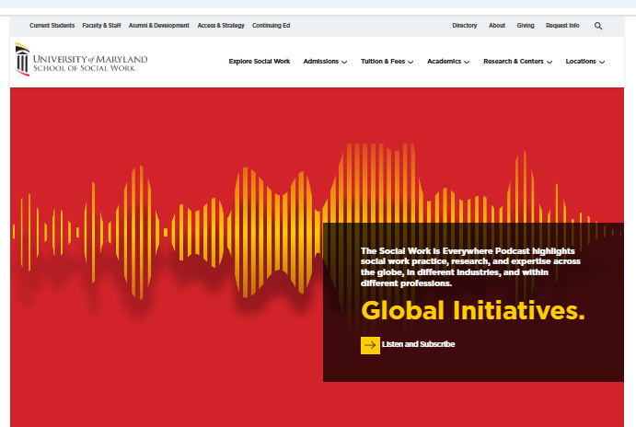
https://www.ssw.umaryland.edu/
Go to SSW website
Select ACADEMICS
Select Practicum Education

Slide 15
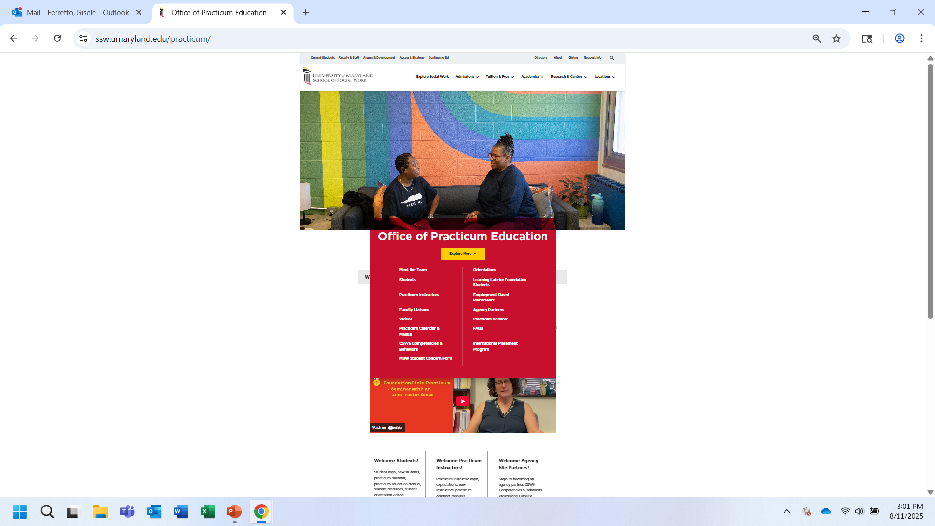
(In Academics) Select Practicum Education
Click on “EXPLORE MORE”

Slide 16
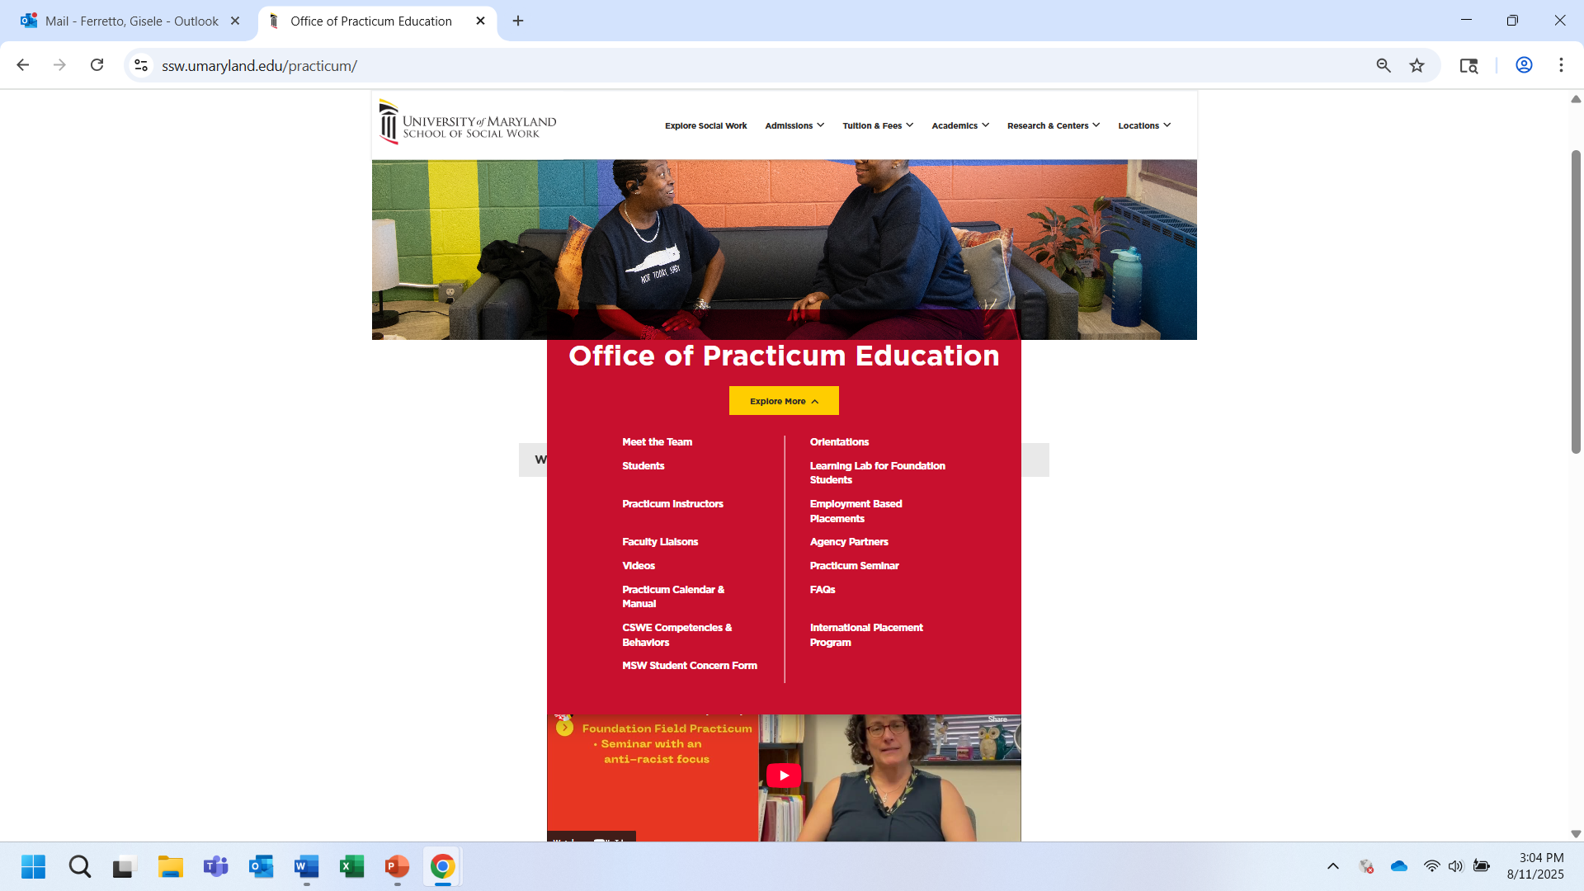
Go to Students Tab for the
Electronic PracticumNotebook

Slide 17
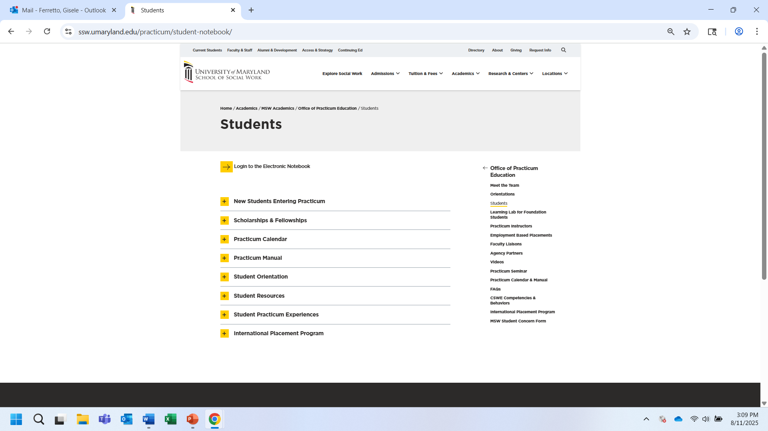
https://www.ssw.umaryland.edu/practicum/student-notebook/
Electronic Practicum Notebook
Calendar & Manual
Videos
SW Competencies

Slide 18
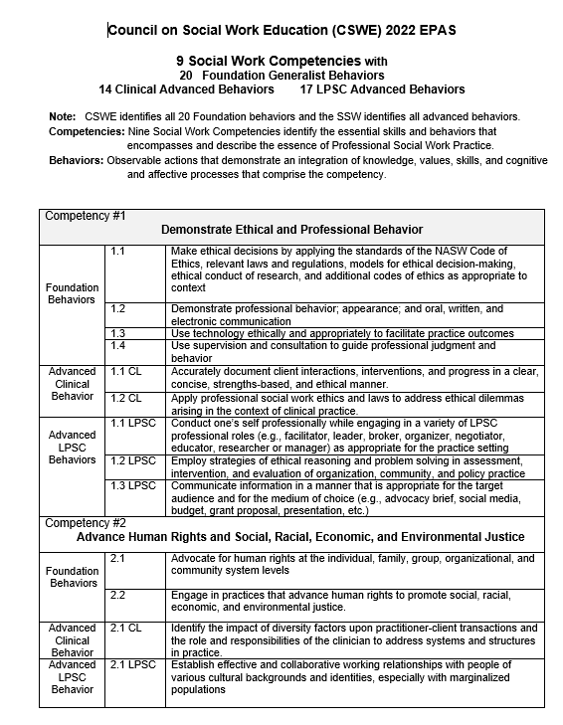
Refer to 2022 CSWE EPAS: 9 Social Work Competencies and Behaviors Located in the Student Orientation Handouts and on the website

Slide 19

Practicum Orientation Videos
REQUIRED: Video 3 and 5
Practicum Education ORIENTATION
Video 1: Practicum is a Course: Assignments, Expectations, Social Work Competencies
Video 2: Cultural Humility in Practicum Education
Video 3: Ethical Responsibilities, Code of Conduct, and Safety
Video 4: Being Prepared for practicum Instruction and Supervision
Video 5: Use of Self: Compassion Satisfaction and Compassion Fatigue
Completing Assignments in the EPN Electronic Practicum Notebook
Video 6: Navigating the EPN
Video 7: Monthly Reports
Video 8: Timesheets
Video 9: Learning Agreements
Video 10: Individual/Clinical Process Recordings
Video 11: Macro Process Recordings
Video 12: Student Competency Assessments/ Evaluations
Connection Between the Classroom and Practicum
Video 13: SOWK 610 Structural Oppression and its Implications for Social Work
Video 14: SOWK 630 Social Work Practice with Individuals
Video 15: SOWK 631 Social Work Practice with Organizations and Communities
Video 16: SOWK 632 Social Work Practice with Groups and Families

Slide 20
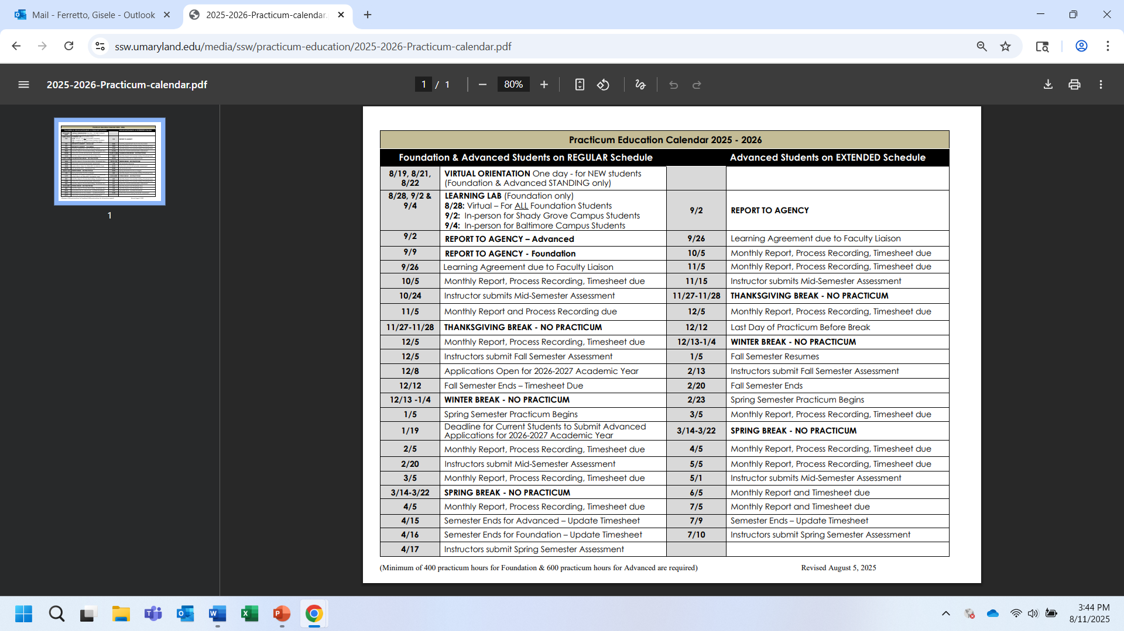
https://www.ssw.umaryland.edu/media/ssw/Practicum-education/2025-2026-Practicum-calendar.pdf

Slide 21
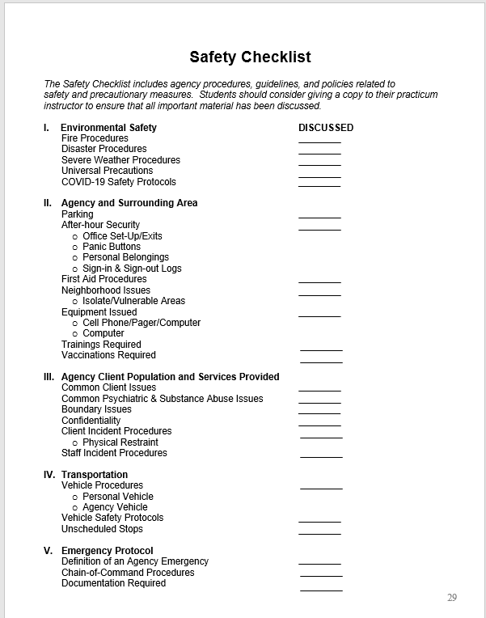
Page 29
in handouts
Safety Checklist

Slide 22
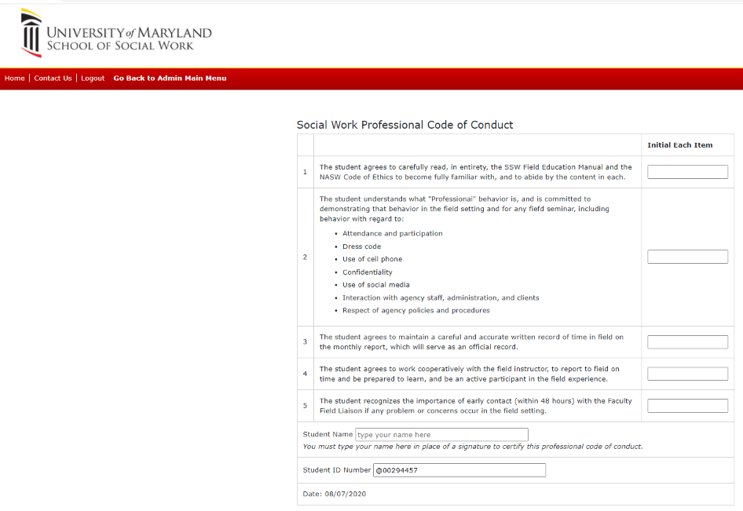
Social Work Professional Code of Conduct
Page 30-36 in handouts

Slide 23
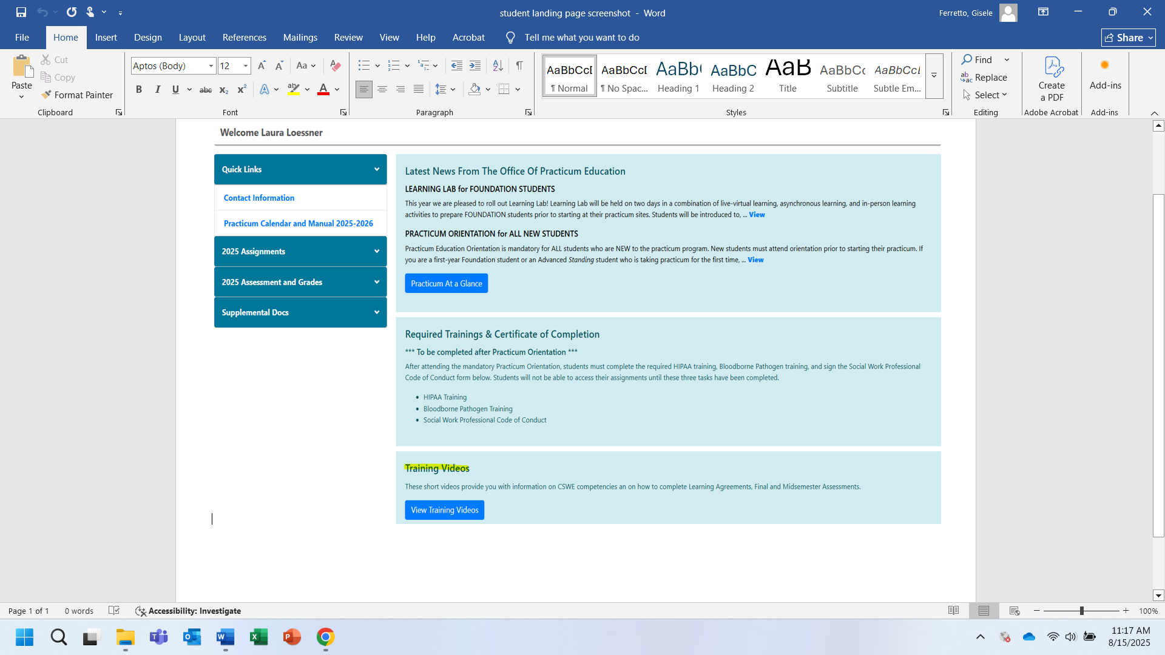
Social Work Professional Code of Conduct on EPN

Slide 24
Questions during your Practicum?
Contact your Practicum Instructor
Contact your Faculty Liaison
Contact your SSW Practicum Coordinator
Check the Electronic Practicum Notebook for the contact information for your practicum instructor, faculty liaison and SSW Practicum Coordinator.
If do not know your SSW Practicum Coordinator contact the Office of Practicum Education general email: practicumeducation@ssw.umaryland.edu
OR call main line: 410-706-7187

Slide 25
Small Groups Handouts pages: 17-32
Introduce yourself to faculty and other students
Open question session
Review of Individual/Clinical Process Recording Outline
Review of Macro Process Recording Outline
Practice Activity: Process Recording
Review of Professional Code of Conduct
Practice Activity: Code of Conduct Practicum Scenarios

Slide 26
Tuesday Small Group Faculty Facilitators
Students will be automatically assigned to a small group
The small groups will NOT be recorded
1 | Angela Jachelski | Don Vince
2 | Caron Cox- Branch | Mixson, Haley
3 | Denise Chop | Kelly Baker Wiese
4 | Esther Carlson | Jackie Ogg
5 | Gisele Ferretto
6 | Laura Loessner | Rosalind Munyiri-Wilson
7 | Madge Henderson
8 | Scott Stafford | Sarah Russ
9 | Claire Meringolo | Jessica Gauthier

Slide 27
Thursday Small Group Faculty Facilitators
Students will be automatically assigned to a small group
The small groups will NOT be recorded
1 | Angela Jachelski | Rosalind Munyiri-Wilson
2 | Caron Cox- Branch | Scott Birdsong
3 | Denise Chop | Daphne McClellan
4 | Esther Carlson | Lane Victorson
5 | Gisele Ferretto
6 | Laura Loessner | Sharon Fishman
7 | Madge Henderson | Marci Kennai

Slide 28
Friday Small Group Faculty Facilitators
Students will be automatically assigned to a small group
The small groups will NOT be recorded
1 | Angela Jachelski | Kenya Hall
2 | Caron Cox- Branch | Michelle Carlstrom
3 | Denise Chop | Lynn Hardesty
4 | Esther Carlson | Lane Victorson
5 | Gisele Ferretto
6 | Laura Loessner | Sharon Fishman
7 | Scott Stafford | Rosalind Munyiri-Wilson

